Slide 1
Introduction
Insu Yun

Slide 2
Course Description
Lecture & Hands-on laboratory
Learn high level concepts for software attacks
Practice attacks with exercise
Prerequisite
EE209 or other equivalent courses (e.g., CS230)
Operating system, system programming, architecture
C, C++, Python

Slide 3
Goal: Lean how hackers attack software vulnerabilities!

Slide 4
Who should take this course?
If you want to study this topic seriously (e.g., research or job) -> You SHOULD take this!
If you are interested in this topic + you have enough free time -> Good to take! It would be fun!
If you are interested in this topic + your schedule is tight -> Think carefully! This would be one of the toughest courses in your life!

Slide 5
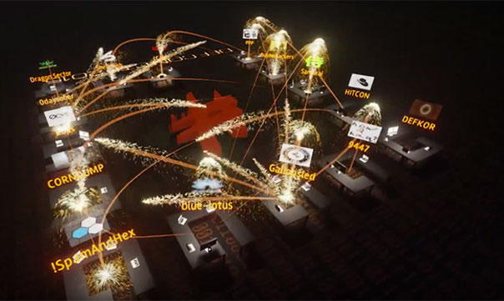
Through Capture The Flag(CTF)
Cyber game like puzzle solving
Types: Jeopardy, Attack and defense

Slide 6
Many people are already enjoying CTF!
ref: ctftime.org

Slide 7
I am also one of them (from DEFCON CTF)
ME ☺

Slide 8
Course Information
Website: teemo.kaist.ac.kr
Instructor: Insu Yun (insuyun@kaist.ac.kr)
TA: Changhun Song (songch@kaist.ac.kr)
Piazza: https://piazza.com/class/kjv59av4pi450v
Register now! Will use for announcing notice
Discord: https://discord.gg/VRaCJ28B
Will use for tutorial + office hour
Teamviewer: https://www.teamviewer.com/en/
WARN: Don’t give your account information to others!
Notes:
TODO: https://discord.gg/VRaCJ28B
TeamViewer:

Slide 9
Office hour
Please participate in this poll: https://doodle.com/poll/k9iqv5d6cmvbi3bn
Please come to discord at the office hour
Notes:
Poll: 화목 4시

Slide 10
Topics
Lab01: Reverse engineering
Lab02: Linux basic + shellcode
Lab03: Stack overflow
Lab04: Bypassing stack protection
Lab05: Bypassing DEP/ASLR
Lab06: Return-oriented programming
Lab07: Remote exploits
Lab08: Miscellaneous attacks
Lab09: Heap exploits

Slide 11
3 types of lectures
General lecture
Explain concepts of each topic
Slides will be uploaded in the website (+video?)
Lab review
At the day of deadline, I will briefly show you how to approach the challenge
Slides will not be uploaded
Tutorial
Go through the tutorial (~ 30minutes)
Join Discord, do yourself, and ask questions

Slide 12
Course structures
Lab assignment: Tutorials (0-2) + 10 challenges
In-class CTF
24 hours
Each team (<= 4 people) needs to prepare one challenge for other team

Slide 13
Lab scoring
For each challenge
Submit a flag with corresponding writeup/exploit
Total: 220 points = 200 points (10 challenges) + 20 point (one tutorial)
In class CTF
Will be counted as TWO labs
i.e., 400 points!
Late policy: 50% of original score (one extra week)

Slide 14
Grading
100%: lab assignment + in-class CTF (400 points at maximum)
Grading scheme
A+: >= 20 * tutorials + 0.75 * (20 * problems + 400)
A0 : >= 20 * tutorials + 0.70 * (20 * problems + 400)
A- : >= 20 * tutorials + 0.65 * (20 * problems + 400)
B+: >= 20 * tutorials + 0.60 * (20 * problems + 400)
B0 : >= 20 * tutorials + 0.55 * (20 * problems + 400)
B- : >= 20 * tutorials + 0.ad50 * (20 * problems + 400)
…

Slide 15
Tips
Study in group (e.g., discussion)
Get help from me and TAs (Office hour, Piazza)
NOTE: Don’t ask questions using discord
Discord is only for tutorials + office hour, but use piazza
Manage your time
Learn basic tools (e.g., gdb, pwntools, python)
Try to tackle in order (not strict)

Slide 16
Tips (2)
Start your assignment as soon as possible
Don’t assume that TAs will respond immediately
Try to solve challenges as much as you can
e.g., Bad strategy: Solve only 7.5 challenge per lab
Later challenges will be much more difficult than earlier ones

Slide 17
Misconduct policy
DO NOT SHARE YOUR CODE WITH OTHER STUDENTS
We encourage you to discuss, but discussion != sharing code
Do not copy other students’ code
Do not copy any public code

Slide 18
About course material
You should never share challenges/exploits/writeups online
Once found → F
Reason: It makes this course less useful for other students

Slide 19
Ethical hacking
DO NOT ATTACK OTHER’s SYSTEM
Attack your own and isolated environment
Use your home directory
DO NOT DoS our server (e.g., fork bomb)

Slide 20
Course homepage: Registration
If you didn’t get your API key, let us know!

Slide 21
Your account sample
Your ID: pseudonym (Using Docker’s generation mechanism)
Your API Key
Your SSH key will be attached!

Slide 22
Course homepage: Home
Click this

Slide 23
Course homepage: Lab

Slide 24
Course homepage: Lab

Slide 25
Note on flag
Format: ee595{...}
e.g., ee595{thi5_i5_s4mple_fla9_f0r_y0u}
Usually, locate at /ee595/[lab_name]/[challenge_name]/flag
e.g., /ee595/lab01/tut01-crackme/flag
Sometimes, a binary embeds the flag itself
e.g., bomlab in lab01
If you cannot find where the flag is, don’t hesitate ask us

Slide 26
Write-up
Markdown format
Ref: https://guides.github.com/features/mastering-markdown/
You should include
Vulnerability description
Summary of your exploit
Your exploit code
A way to reproduce your exploit
Collaborator
Be concise yet precise

Slide 27
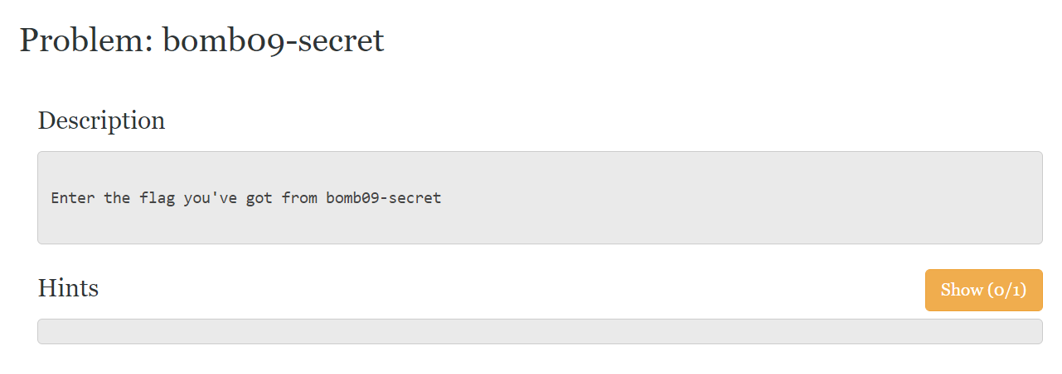
Hint system
Some challenges have hints for you.
If you want, feel free to open it!

Slide 28
CTF server
ssh YOUR_ID@teemo.kaist.ac.kr –p 9000 –i YOUR_PRIVATE_KEY
cd /ee595/lab01
cat README

