Slide 1
Reverse Engineering
Insu Yun

Slide 2
What is reverse engineering?
Engineering
Logic
Code
Binary
Reverse Engineering
Logic
Code
Binary

Slide 3
Reverse engineering is challenging due to loss of information
No variable or function names
void decode_string(char* str, int len) {
// XOR string with a given length
for (int i = 0; i < len; i++) {
*str ^= 42;
str++;
}
}
No comment
Ambiguous representation

Slide 4
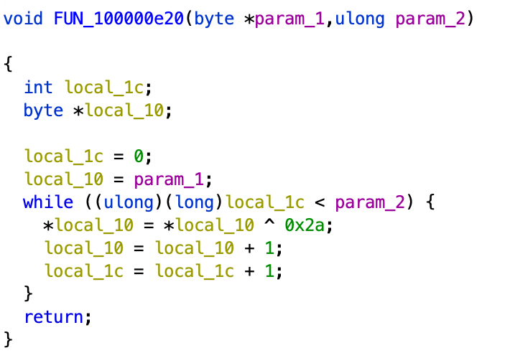
Static analysis vs Dynamic analysis
Static analysis: Read and understand binary
+ Give deep understanding (e.g., FUN_100000e20 == decode_string? + Can find an input to make ”Hello World”) - Time consuming
- Error-prone
Dynamic analysis: Run and infer from results
+ Understand logic without expensive analysis (e.g., FUN_ 100000e20(cryptic, 12) gives us “Hello World”, => FUN_ 100000e20 == decode_string?)
- Shallow understanding

Slide 5
x86 assembly
; add
0x08048426 <+0>: push ebp
0x08048427 <+1>: mov ebp,esp
0x08048429 <+3>: mov edx,DWORD PTR [ebp+0x8]
0x0804842c <+6>: mov eax,DWORD PTR [ebp+0xc]
0x0804842f <+9>: add eax,edx
0x08048431 <+11>: pop ebp
0x08048432 <+12>: ret
; main
0x08048403 <+0>: push ebp
0x08048404 <+1>: mov ebp,esp
0x08048406 <+3>: sub esp,0x8
0x08048409 <+6>: mov DWORD PTR [ebp-0x8],0x3
0x08048410 <+13>: mov DWORD PTR [ebp-0x4],0x7
0x08048417 <+20>: push DWORD PTR [ebp-0x4]
0x0804841a <+23>: push DWORD PTR [ebp-0x8]
0x0804841d <+26>: call 0x80483f6 <add>
0x08048422 <+31>: add esp,0x8
0x08048425 <+34>: mov eax,0x0
0x0804842a <+39>: leave
0x0804842b <+40>: ret
int add(int a, int b) {
return a + b;
}
int main() {
int a = 3;
int b = 7;
add(a, b);
}

Slide 6
x86 assembly (Registers)
Small and fast in-CPU memory that can store variables
General purpose registers
64bit: rax, rbx, rcx, rdx, rdi, rsi, r8-r15, etc. (8byte)
32bit: eax, ebx, ecx, edx, edi, esi (4byte)
RAX
EAX
AX
AL
64
32
16
8

Slide 7
x86 assembly (Special registers)
Program counter
64bit: rip
32bit: eip
Stack management
64bit: rsp, rbp
32bit: ebp, esp

Slide 8
x86 assembly (Syntax)
[operator] [operand1], [operand2], etc.
Two types of x86 assembly syntax styles exist
Intel syntax: [operator] [destination], [source]
AT&T syntax: [operator] [source], [destination]
We will use Intel syntax in this course

Slide 9
x86 assembly (Examples)
mov eax, 1 - Store the value 1 into the eax register
mov eax, ebx - Move the value of ebx to eax, (i.e., eax = ebx)
add eax, 1 - Add 1 to eax, (i.e., eax = eax + 1)
imul eax, ebx - Multiply ebx and eax and store the result into eax
Others: sub, xor, or, and, shl, ashr, lshr, …

Slide 10
x86 assembly (More examples)
lea eax, DWORD PTR [ebp – 4]
Load effective address; Store ebp-4 to eax
mov eax, DWORD PTR [ebp – 4]
Move the value stored at address ebp-4 to eax
mov DWORD PTR [ebp – 4], eax
Store the value of eax to the address of ebp-4

Slide 11
x86 assembly (More examples)
mov eax, DWORD PTR [ebp – 4]
Move 4 bytes stored at address ebp-4 to eax
mov ax, WORD PTR [ebp – 4]
Move 2 bytes stored at address ebp-4 to ax
mov al, BYTE PTR [ebp – 4]
Move 1 byte stored at address ebp-4 to al

Slide 12
x86 assembly (Stack)
push $src
== sub esp, 4 mov [esp], src
pop $dst
== mov $dst, [esp] add esp, 4
leave == mov esp, ebp pop ebp

Slide 13
x86 assembly (Control flow)
cmp DWORD PTR [ebp – 4], 0x1234
Compare the value of the address ebp-4 to 0x1234 and set EFLAGS
i.e., if (i == 0x1234)
Conditional jump
je 0x8048442 <main+94> ← Equal or zero
jne 0x8048442 <main+94> ← Not equal or non-zero
jle 0x8048442 <main+94> ← Less or equal, signed
jbe 0x8048442 <main+94> ← Below or equal, unsigned
jge 0x8048442 <main+94> ← Greater or equal, signed
jae 0x8048442 <main+94> ← Above or equal, unsigned

Slide 14
x86 assembly (Control flow)
Unconditional jump
jmp 0x8048442 <main+94>
Function call
call 0x8048426 <add>
Push a next instruction address (i.e., return address) to stack and jump
ret == pop eip

Slide 15
Endianness
Byte order to store multi-byte data
Big Endian: Most significant byte -> Lowest address
Little Endian: Most significant byte -> Highest address
e.g., mov DWORD PTR [eax], 0x41424344
0x08048003 | 0x44
0x08048002 | 0x43
0x08048001 | 0x42
0x08048000 | 0x41
0x08048003 | 0x41
0x08048002 | 0x42
0x08048001 | 0x43
0x08048000 | 0x44
Big Endian
Little Endian (x86)

Slide 16
Memory Layout
0xffffffff
Stack
Stack
Local variables, call contexts, …
Up to 8MB in Linux by default
Heap
Dynamically allocated data
.data
Readable/writeable global variables
.rodata
Read-only data (e.g., “Hello World”)
.text
Read-only code
Heap
.data
.rodata
.text
0x08048000
0x00000000

Slide 17
Call stack
void baz() {
bar();
...
}
void bar() {
foo();
...
}
void foo() {
...
}
ebp
baz()
esp

Slide 18
Call stack
void baz() {
bar();
...
}
void bar() {
foo();
...
}
void foo() {
...
}
baz()
ebp
bar()
esp

Slide 19
Call stack
void baz() {
bar();
...
}
void bar() {
foo();
...
}
void foo() {
...
}
baz()
bar()
ebp
foo()
esp

Slide 20
Call stack
void baz() {
bar();
...
}
void bar() {
foo();
...
}
void foo() {
...
}
baz()
ebp
bar()
esp

Slide 21
Call stack
void baz() {
bar();
...
}
void bar() {
foo();
...
}
void foo() {
...
}
ebp
baz()
esp

Slide 22
Stack frame
Parameter2
Parameter1
Return address
Old ebp
Local variable 1
Local variable 2
...
Local variable N
ebp
esp
caller stack

Slide 23
Stack frame
Parameter2
Parameter1
Return address
Old ebp
Local variable 1
Local variable 2
...
Local variable N
ebp
esp
caller stack

Slide 24
Stack frame
Parameter2
Parameter1
Return address
Old ebp
Local variable 1
Local variable 2
...
Local variable N
ebp
esp
caller stack

Slide 25
Stack frame
Parameter2
Parameter1
Return address
Old ebp
Local variable 1
Local variable 2
...
Local variable N
ebp
esp
caller stack

Slide 26
x86 Calling convention (GCC)
Function arguments
Save to stack
Return value
eax
Register preservation
Callee-saved: ebp, edi, esi, ebx
Caller-saved: others

Slide 27
x86 assembly
; add
0x08048426 <+0>: push ebp
0x08048427 <+1>: mov ebp,esp
0x08048429 <+3>: mov edx,DWORD PTR [ebp+0x8]
0x0804842c <+6>: mov eax,DWORD PTR [ebp+0xc]
0x0804842f <+9>: add eax,edx
0x08048431 <+11>: pop ebp
0x08048432 <+12>: ret
; main
0x08048403 <+0>: push ebp
0x08048404 <+1>: mov ebp,esp
0x08048406 <+3>: sub esp,0x8
0x08048409 <+6>: mov DWORD PTR [ebp-0x8],0x3
0x08048410 <+13>: mov DWORD PTR [ebp-0x4],0x7
0x08048417 <+20>: push DWORD PTR [ebp-0x4]
0x0804841a <+23>: push DWORD PTR [ebp-0x8]
0x0804841d <+26>: call 0x80483f6 <add>
0x08048422 <+31>: add esp,0x8
0x08048425 <+34>: mov eax,0x0
0x0804842a <+39>: leave
0x0804842b <+40>: ret
int add(int a, int b) {
return a + b;
}
int main() {
int a = 3;
int b = 7;
add(a, b);
}

Slide 28
; add
0x08048426 <+0>: push ebp
0x08048427 <+1>: mov ebp,esp
0x08048429 <+3>: mov edx,DWORD PTR [ebp+0x8]
0x0804842c <+6>: mov eax,DWORD PTR [ebp+0xc]
0x0804842f <+9>: add eax,edx
0x08048431 <+11>: pop ebp
0x08048432 <+12>: ret
; main
0x08048403 <+0>: push ebp
0x08048404 <+1>: mov ebp,esp
0x08048406 <+3>: sub esp,0x8
0x08048409 <+6>: mov DWORD PTR [ebp-0x8],0x3
0x08048410 <+13>: mov DWORD PTR [ebp-0x4],0x7
0x08048417 <+20>: push DWORD PTR [ebp-0x4]
0x0804841a <+23>: push DWORD PTR [ebp-0x8]
0x0804841d <+26>: call 0x80483f6 <add>
0x08048422 <+31>: add esp,0x8
0x08048425 <+34>: mov eax,0x0
0x0804842a <+39>: leave
0x0804842b <+40>: ret
...
main’s return address
esp
eip

Slide 29
; add
0x08048426 <+0>: push ebp
0x08048427 <+1>: mov ebp,esp
0x08048429 <+3>: mov edx,DWORD PTR [ebp+0x8]
0x0804842c <+6>: mov eax,DWORD PTR [ebp+0xc]
0x0804842f <+9>: add eax,edx
0x08048431 <+11>: pop ebp
0x08048432 <+12>: ret
; main
0x08048403 <+0>: push ebp
0x08048404 <+1>: mov ebp,esp
0x08048406 <+3>: sub esp,0x8
0x08048409 <+6>: mov DWORD PTR [ebp-0x8],0x3
0x08048410 <+13>: mov DWORD PTR [ebp-0x4],0x7
0x08048417 <+20>: push DWORD PTR [ebp-0x4]
0x0804841a <+23>: push DWORD PTR [ebp-0x8]
0x0804841d <+26>: call 0x80483f6 <add>
0x08048422 <+31>: add esp,0x8
0x08048425 <+34>: mov eax,0x0
0x0804842a <+39>: leave
0x0804842b <+40>: ret
...
main’s return address
main’s old ebp
esp

Slide 30
; add
0x08048426 <+0>: push ebp
0x08048427 <+1>: mov ebp,esp
0x08048429 <+3>: mov edx,DWORD PTR [ebp+0x8]
0x0804842c <+6>: mov eax,DWORD PTR [ebp+0xc]
0x0804842f <+9>: add eax,edx
0x08048431 <+11>: pop ebp
0x08048432 <+12>: ret
; main
0x08048403 <+0>: push ebp
0x08048404 <+1>: mov ebp,esp
0x08048406 <+3>: sub esp,0x8
0x08048409 <+6>: mov DWORD PTR [ebp-0x8],0x3
0x08048410 <+13>: mov DWORD PTR [ebp-0x4],0x7
0x08048417 <+20>: push DWORD PTR [ebp-0x4]
0x0804841a <+23>: push DWORD PTR [ebp-0x8]
0x0804841d <+26>: call 0x80483f6 <add>
0x08048422 <+31>: add esp,0x8
0x08048425 <+34>: mov eax,0x0
0x0804842a <+39>: leave
0x0804842b <+40>: ret
...
main’s return address
main’s old ebp
ebp
esp

Slide 31
; add
0x08048426 <+0>: push ebp
0x08048427 <+1>: mov ebp,esp
0x08048429 <+3>: mov edx,DWORD PTR [ebp+0x8]
0x0804842c <+6>: mov eax,DWORD PTR [ebp+0xc]
0x0804842f <+9>: add eax,edx
0x08048431 <+11>: pop ebp
0x08048432 <+12>: ret
; main
0x08048403 <+0>: push ebp
0x08048404 <+1>: mov ebp,esp
0x08048406 <+3>: sub esp,0x8
0x08048409 <+6>: mov DWORD PTR [ebp-0x8],0x3
0x08048410 <+13>: mov DWORD PTR [ebp-0x4],0x7
0x08048417 <+20>: push DWORD PTR [ebp-0x4]
0x0804841a <+23>: push DWORD PTR [ebp-0x8]
0x0804841d <+26>: call 0x80483f6 <add>
0x08048422 <+31>: add esp,0x8
0x08048425 <+34>: mov eax,0x0
0x0804842a <+39>: leave
0x0804842b <+40>: ret
...
main’s return address
main’s old ebp
ebp
esp

Slide 32
; add
0x08048426 <+0>: push ebp
0x08048427 <+1>: mov ebp,esp
0x08048429 <+3>: mov edx,DWORD PTR [ebp+0x8]
0x0804842c <+6>: mov eax,DWORD PTR [ebp+0xc]
0x0804842f <+9>: add eax,edx
0x08048431 <+11>: pop ebp
0x08048432 <+12>: ret
; main
0x08048403 <+0>: push ebp
0x08048404 <+1>: mov ebp,esp
0x08048406 <+3>: sub esp,0x8
0x08048409 <+6>: mov DWORD PTR [ebp-0x8],0x3
0x08048410 <+13>: mov DWORD PTR [ebp-0x4],0x7
0x08048417 <+20>: push DWORD PTR [ebp-0x4]
0x0804841a <+23>: push DWORD PTR [ebp-0x8]
0x0804841d <+26>: call 0x80483f6 <add>
0x08048422 <+31>: add esp,0x8
0x08048425 <+34>: mov eax,0x0
0x0804842a <+39>: leave
0x0804842b <+40>: ret
...
main’s return address
main’s old ebp
a = 3
ebp
esp

Slide 33
; add
0x08048426 <+0>: push ebp
0x08048427 <+1>: mov ebp,esp
0x08048429 <+3>: mov edx,DWORD PTR [ebp+0x8]
0x0804842c <+6>: mov eax,DWORD PTR [ebp+0xc]
0x0804842f <+9>: add eax,edx
0x08048431 <+11>: pop ebp
0x08048432 <+12>: ret
; main
0x08048403 <+0>: push ebp
0x08048404 <+1>: mov ebp,esp
0x08048406 <+3>: sub esp,0x8
0x08048409 <+6>: mov DWORD PTR [ebp-0x8],0x3
0x08048410 <+13>: mov DWORD PTR [ebp-0x4],0x7
0x08048417 <+20>: push DWORD PTR [ebp-0x4]
0x0804841a <+23>: push DWORD PTR [ebp-0x8]
0x0804841d <+26>: call 0x80483f6 <add>
0x08048422 <+31>: add esp,0x8
0x08048425 <+34>: mov eax,0x0
0x0804842a <+39>: leave
0x0804842b <+40>: ret
...
main’s return address
main’s old ebp
b = 7
a = 3
ebp
esp

Slide 34
; add
0x08048426 <+0>: push ebp
0x08048427 <+1>: mov ebp,esp
0x08048429 <+3>: mov edx,DWORD PTR [ebp+0x8]
0x0804842c <+6>: mov eax,DWORD PTR [ebp+0xc]
0x0804842f <+9>: add eax,edx
0x08048431 <+11>: pop ebp
0x08048432 <+12>: ret
; main
0x08048403 <+0>: push ebp
0x08048404 <+1>: mov ebp,esp
0x08048406 <+3>: sub esp,0x8
0x08048409 <+6>: mov DWORD PTR [ebp-0x8],0x3
0x08048410 <+13>: mov DWORD PTR [ebp-0x4],0x7
0x08048417 <+20>: push DWORD PTR [ebp-0x4]
0x0804841a <+23>: push DWORD PTR [ebp-0x8]
0x0804841d <+26>: call 0x80483f6 <add>
0x08048422 <+31>: add esp,0x8
0x08048425 <+34>: mov eax,0x0
0x0804842a <+39>: leave
0x0804842b <+40>: ret
...
main’s return address
main’s old ebp
b = 7
a = 3
7
ebp
esp

Slide 35
; add
0x08048426 <+0>: push ebp
0x08048427 <+1>: mov ebp,esp
0x08048429 <+3>: mov edx,DWORD PTR [ebp+0x8]
0x0804842c <+6>: mov eax,DWORD PTR [ebp+0xc]
0x0804842f <+9>: add eax,edx
0x08048431 <+11>: pop ebp
0x08048432 <+12>: ret
; main
0x08048403 <+0>: push ebp
0x08048404 <+1>: mov ebp,esp
0x08048406 <+3>: sub esp,0x8
0x08048409 <+6>: mov DWORD PTR [ebp-0x8],0x3
0x08048410 <+13>: mov DWORD PTR [ebp-0x4],0x7
0x08048417 <+20>: push DWORD PTR [ebp-0x4]
0x0804841a <+23>: push DWORD PTR [ebp-0x8]
0x0804841d <+26>: call 0x80483f6 <add>
0x08048422 <+31>: add esp,0x8
0x08048425 <+34>: mov eax,0x0
0x0804842a <+39>: leave
0x0804842b <+40>: ret
...
main’s return address
main’s old ebp
b = 7
a = 3
7
3
ebp
esp

Slide 36
; add
0x08048426 <+0>: push ebp
0x08048427 <+1>: mov ebp,esp
0x08048429 <+3>: mov edx,DWORD PTR [ebp+0x8]
0x0804842c <+6>: mov eax,DWORD PTR [ebp+0xc]
0x0804842f <+9>: add eax,edx
0x08048431 <+11>: pop ebp
0x08048432 <+12>: ret
; main
0x08048403 <+0>: push ebp
0x08048404 <+1>: mov ebp,esp
0x08048406 <+3>: sub esp,0x8
0x08048409 <+6>: mov DWORD PTR [ebp-0x8],0x3
0x08048410 <+13>: mov DWORD PTR [ebp-0x4],0x7
0x08048417 <+20>: push DWORD PTR [ebp-0x4]
0x0804841a <+23>: push DWORD PTR [ebp-0x8]
0x0804841d <+26>: call 0x80483f6 <add>
0x08048422 <+31>: add esp,0x8
0x08048425 <+34>: mov eax,0x0
0x0804842a <+39>: leave
0x0804842b <+40>: ret
...
main’s return address
main’s old ebp
b = 7
a = 3
7
3
add’s return address
ebp
esp

Slide 37
; add
0x08048426 <+0>: push ebp
0x08048427 <+1>: mov ebp,esp
0x08048429 <+3>: mov edx,DWORD PTR [ebp+0x8]
0x0804842c <+6>: mov eax,DWORD PTR [ebp+0xc]
0x0804842f <+9>: add eax,edx
0x08048431 <+11>: pop ebp
0x08048432 <+12>: ret
; main
0x08048403 <+0>: push ebp
0x08048404 <+1>: mov ebp,esp
0x08048406 <+3>: sub esp,0x8
0x08048409 <+6>: mov DWORD PTR [ebp-0x8],0x3
0x08048410 <+13>: mov DWORD PTR [ebp-0x4],0x7
0x08048417 <+20>: push DWORD PTR [ebp-0x4]
0x0804841a <+23>: push DWORD PTR [ebp-0x8]
0x0804841d <+26>: call 0x80483f6 <add>
0x08048422 <+31>: add esp,0x8
0x08048425 <+34>: mov eax,0x0
0x0804842a <+39>: leave
0x0804842b <+40>: ret
...
main’s return address
main’s old ebp
b = 7
a = 3
7
3
add’s return address
add’s old ebp
ebp
esp

Slide 38
; add
0x08048426 <+0>: push ebp
0x08048427 <+1>: mov ebp,esp
0x08048429 <+3>: mov edx,DWORD PTR [ebp+0x8]
0x0804842c <+6>: mov eax,DWORD PTR [ebp+0xc]
0x0804842f <+9>: add eax,edx
0x08048431 <+11>: pop ebp
0x08048432 <+12>: ret
; main
0x08048403 <+0>: push ebp
0x08048404 <+1>: mov ebp,esp
0x08048406 <+3>: sub esp,0x8
0x08048409 <+6>: mov DWORD PTR [ebp-0x8],0x3
0x08048410 <+13>: mov DWORD PTR [ebp-0x4],0x7
0x08048417 <+20>: push DWORD PTR [ebp-0x4]
0x0804841a <+23>: push DWORD PTR [ebp-0x8]
0x0804841d <+26>: call 0x80483f6 <add>
0x08048422 <+31>: add esp,0x8
0x08048425 <+34>: mov eax,0x0
0x0804842a <+39>: leave
0x0804842b <+40>: ret
...
main’s return address
main’s old ebp
b = 7
a = 3
7
3
add’s return address
add’s old ebp
ebp
esp

Slide 39
; add
0x08048426 <+0>: push ebp
0x08048427 <+1>: mov ebp,esp
0x08048429 <+3>: mov edx,DWORD PTR [ebp+0x8]
0x0804842c <+6>: mov eax,DWORD PTR [ebp+0xc]
0x0804842f <+9>: add eax,edx
0x08048431 <+11>: pop ebp
0x08048432 <+12>: ret
; main
0x08048403 <+0>: push ebp
0x08048404 <+1>: mov ebp,esp
0x08048406 <+3>: sub esp,0x8
0x08048409 <+6>: mov DWORD PTR [ebp-0x8],0x3
0x08048410 <+13>: mov DWORD PTR [ebp-0x4],0x7
0x08048417 <+20>: push DWORD PTR [ebp-0x4]
0x0804841a <+23>: push DWORD PTR [ebp-0x8]
0x0804841d <+26>: call 0x80483f6 <add>
0x08048422 <+31>: add esp,0x8
0x08048425 <+34>: mov eax,0x0
0x0804842a <+39>: leave
0x0804842b <+40>: ret
...
main’s return address
main’s old ebp
b = 7
a = 3
7
3
add’s return address
add’s old ebp
edx = 3
ebp
esp

Slide 40
; add
0x08048426 <+0>: push ebp
0x08048427 <+1>: mov ebp,esp
0x08048429 <+3>: mov edx,DWORD PTR [ebp+0x8]
0x0804842c <+6>: mov eax,DWORD PTR [ebp+0xc]
0x0804842f <+9>: add eax,edx
0x08048431 <+11>: pop ebp
0x08048432 <+12>: ret
; main
0x08048403 <+0>: push ebp
0x08048404 <+1>: mov ebp,esp
0x08048406 <+3>: sub esp,0x8
0x08048409 <+6>: mov DWORD PTR [ebp-0x8],0x3
0x08048410 <+13>: mov DWORD PTR [ebp-0x4],0x7
0x08048417 <+20>: push DWORD PTR [ebp-0x4]
0x0804841a <+23>: push DWORD PTR [ebp-0x8]
0x0804841d <+26>: call 0x80483f6 <add>
0x08048422 <+31>: add esp,0x8
0x08048425 <+34>: mov eax,0x0
0x0804842a <+39>: leave
0x0804842b <+40>: ret
...
main’s return address
main’s old ebp
b = 7
a = 3
7
3
add’s return address
add’s old ebp
eax = 7
ebp
esp

Slide 41
; add
0x08048426 <+0>: push ebp
0x08048427 <+1>: mov ebp,esp
0x08048429 <+3>: mov edx,DWORD PTR [ebp+0x8]
0x0804842c <+6>: mov eax,DWORD PTR [ebp+0xc]
0x0804842f <+9>: add eax,edx
0x08048431 <+11>: pop ebp
0x08048432 <+12>: ret
; main
0x08048403 <+0>: push ebp
0x08048404 <+1>: mov ebp,esp
0x08048406 <+3>: sub esp,0x8
0x08048409 <+6>: mov DWORD PTR [ebp-0x8],0x3
0x08048410 <+13>: mov DWORD PTR [ebp-0x4],0x7
0x08048417 <+20>: push DWORD PTR [ebp-0x4]
0x0804841a <+23>: push DWORD PTR [ebp-0x8]
0x0804841d <+26>: call 0x80483f6 <add>
0x08048422 <+31>: add esp,0x8
0x08048425 <+34>: mov eax,0x0
0x0804842a <+39>: leave
0x0804842b <+40>: ret
...
main’s return address
main’s old ebp
b = 7
a = 3
7
3
add’s return address
add’s old ebp
eax = 7 + 3 = 10
ebp
esp

Slide 42
; add
0x08048426 <+0>: push ebp
0x08048427 <+1>: mov ebp,esp
0x08048429 <+3>: mov edx,DWORD PTR [ebp+0x8]
0x0804842c <+6>: mov eax,DWORD PTR [ebp+0xc]
0x0804842f <+9>: add eax,edx
0x08048431 <+11>: pop ebp
0x08048432 <+12>: ret
; main
0x08048403 <+0>: push ebp
0x08048404 <+1>: mov ebp,esp
0x08048406 <+3>: sub esp,0x8
0x08048409 <+6>: mov DWORD PTR [ebp-0x8],0x3
0x08048410 <+13>: mov DWORD PTR [ebp-0x4],0x7
0x08048417 <+20>: push DWORD PTR [ebp-0x4]
0x0804841a <+23>: push DWORD PTR [ebp-0x8]
0x0804841d <+26>: call 0x80483f6 <add>
0x08048422 <+31>: add esp,0x8
0x08048425 <+34>: mov eax,0x0
0x0804842a <+39>: leave
0x0804842b <+40>: ret
...
main’s return address
main’s old ebp
b = 7
a = 3
7
3
add’s return address
add’s old ebp
ebp
esp

Slide 43
; add
0x08048426 <+0>: push ebp
0x08048427 <+1>: mov ebp,esp
0x08048429 <+3>: mov edx,DWORD PTR [ebp+0x8]
0x0804842c <+6>: mov eax,DWORD PTR [ebp+0xc]
0x0804842f <+9>: add eax,edx
0x08048431 <+11>: pop ebp
0x08048432 <+12>: ret
; main
0x08048403 <+0>: push ebp
0x08048404 <+1>: mov ebp,esp
0x08048406 <+3>: sub esp,0x8
0x08048409 <+6>: mov DWORD PTR [ebp-0x8],0x3
0x08048410 <+13>: mov DWORD PTR [ebp-0x4],0x7
0x08048417 <+20>: push DWORD PTR [ebp-0x4]
0x0804841a <+23>: push DWORD PTR [ebp-0x8]
0x0804841d <+26>: call 0x80483f6 <add>
0x08048422 <+31>: add esp,0x8
0x08048425 <+34>: mov eax,0x0
0x0804842a <+39>: leave
0x0804842b <+40>: ret
...
main’s return address
main’s old ebp
b = 7
a = 3
7
3
add’s return address
add’s old ebp
ebp
esp

Slide 44
; add
0x08048426 <+0>: push ebp
0x08048427 <+1>: mov ebp,esp
0x08048429 <+3>: mov edx,DWORD PTR [ebp+0x8]
0x0804842c <+6>: mov eax,DWORD PTR [ebp+0xc]
0x0804842f <+9>: add eax,edx
0x08048431 <+11>: pop ebp
0x08048432 <+12>: ret
; main
0x08048403 <+0>: push ebp
0x08048404 <+1>: mov ebp,esp
0x08048406 <+3>: sub esp,0x8
0x08048409 <+6>: mov DWORD PTR [ebp-0x8],0x3
0x08048410 <+13>: mov DWORD PTR [ebp-0x4],0x7
0x08048417 <+20>: push DWORD PTR [ebp-0x4]
0x0804841a <+23>: push DWORD PTR [ebp-0x8]
0x0804841d <+26>: call 0x80483f6 <add>
0x08048422 <+31>: add esp,0x8
0x08048425 <+34>: mov eax,0x0
0x0804842a <+39>: leave
0x0804842b <+40>: ret
...
main’s return address
main’s old ebp
b = 7
a = 3
7
3
add’s return address
add’s old ebp
ebp
esp

Slide 45
; add
0x08048426 <+0>: push ebp
0x08048427 <+1>: mov ebp,esp
0x08048429 <+3>: mov edx,DWORD PTR [ebp+0x8]
0x0804842c <+6>: mov eax,DWORD PTR [ebp+0xc]
0x0804842f <+9>: add eax,edx
0x08048431 <+11>: pop ebp
0x08048432 <+12>: ret
; main
0x08048403 <+0>: push ebp
0x08048404 <+1>: mov ebp,esp
0x08048406 <+3>: sub esp,0x8
0x08048409 <+6>: mov DWORD PTR [ebp-0x8],0x3
0x08048410 <+13>: mov DWORD PTR [ebp-0x4],0x7
0x08048417 <+20>: push DWORD PTR [ebp-0x4]
0x0804841a <+23>: push DWORD PTR [ebp-0x8]
0x0804841d <+26>: call 0x80483f6 <add>
0x08048422 <+31>: add esp,0x8
0x08048425 <+34>: mov eax,0x0
0x0804842a <+39>: leave
0x0804842b <+40>: ret
...
main’s return address
main’s old ebp
b = 7
a = 3
7
3
add’s return address
add’s old ebp
ebp
esp

Slide 46
; add
0x08048426 <+0>: push ebp
0x08048427 <+1>: mov ebp,esp
0x08048429 <+3>: mov edx,DWORD PTR [ebp+0x8]
0x0804842c <+6>: mov eax,DWORD PTR [ebp+0xc]
0x0804842f <+9>: add eax,edx
0x08048431 <+11>: pop ebp
0x08048432 <+12>: ret
; main
0x08048403 <+0>: push ebp
0x08048404 <+1>: mov ebp,esp
0x08048406 <+3>: sub esp,0x8
0x08048409 <+6>: mov DWORD PTR [ebp-0x8],0x3
0x08048410 <+13>: mov DWORD PTR [ebp-0x4],0x7
0x08048417 <+20>: push DWORD PTR [ebp-0x4]
0x0804841a <+23>: push DWORD PTR [ebp-0x8]
0x0804841d <+26>: call 0x80483f6 <add>
0x08048422 <+31>: add esp,0x8
0x08048425 <+34>: mov eax,0x0
0x0804842a <+39>: leave
0x0804842b <+40>: ret
...
main’s return address
main’s old ebp
b = 7
a = 3
7
3
add’s return address
add’s old ebp
esp

Slide 47
x86 Calling convention (GCC)
Function arguments
Save to stack
Return value
eax
Register preservation
Callee-saved: ebp, edi, esi, ebx
Caller-saved: others
Function arguments
rdi, rsi, rdx, rcx, r8, r9
Save to stack
Return value
rax
Register preservation
Callee-saved: rbp, rdi, rsi, rbx, r12-r15
Caller-saved: others
x86 (32bit)
x86-64

Slide 48
Tool for dynamic analysis: GNU DeBugger (GDB)
Can read assembly of a program
disassemble main
Can read the status of a program such as registers and memory
x/[Length?][Format] [Expression]
x/wx $eax (print the value of eax as 32-bit integer)
x/s 0x804858f (read the string value at the address 0x804858f)
x/wx 0x804858f (read the integer value at the address 0x804858f)
Can set a breakpoint
b main (break if main function is called)
b *main+53 (break before running the instruction at main+53)

Slide 49
GDB cont.
Execute a program
r
Controlling the execution after a break
c (continue to a next breakpoint)
ni (run a instruction, do not get into the function)
si (run an instruction, get into the function)

Slide 50
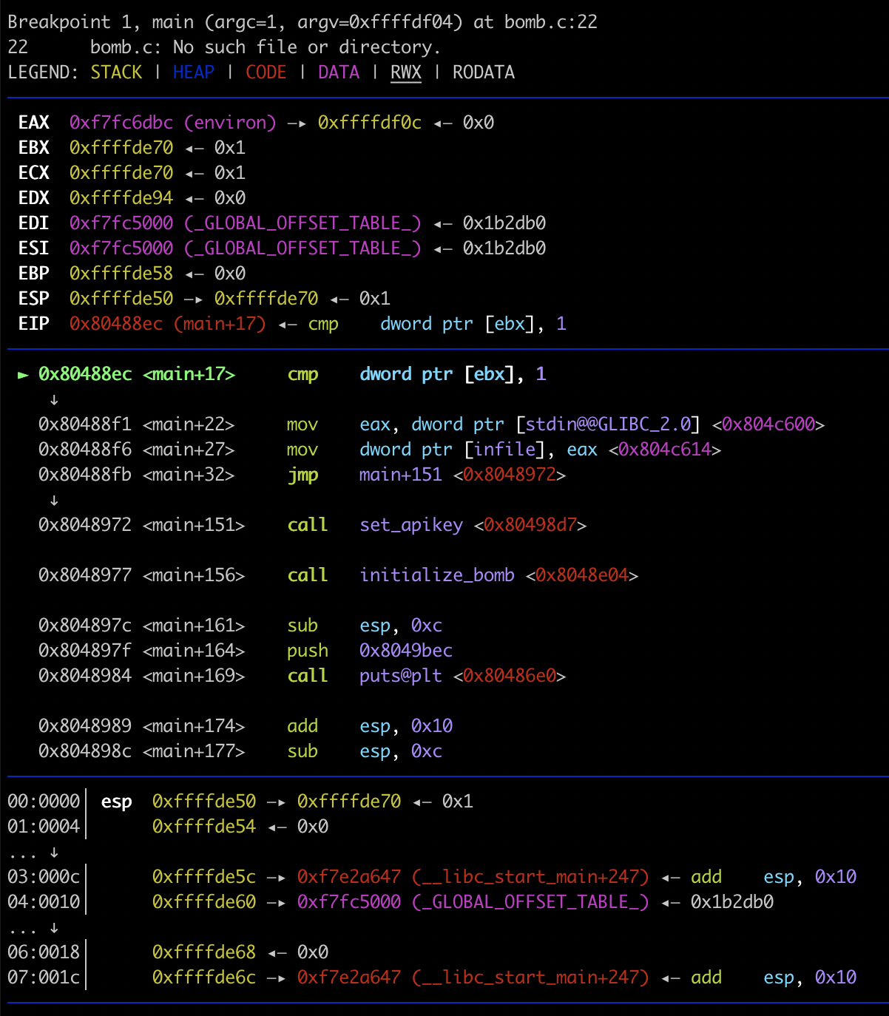
pwndbg
A gdb plugin for exploit development
We highly recommend to use pwndbg (which is install by default) for your further assignment
Ref: https://github.com/pwndbg/pwndbg

Slide 51
Tool for static analysis: Ghidra
Ghidra: A decompiler developed by NSA
IDA would be better, but too expensive ☹
You can download https://ghidra-sre.org/

Slide 52
How to use ghidra
Create a new project: File -> New project
Import a file: File -> Import a file
e.g., scp -P9000 YOUR_ID@teemo.kaist.ac.kr:/ee595/lab01/tut01-crackme/crackme0x00 ./
NOTE: -P is a capital character unlike ssh
Or you can use filezilla for ssh copy

Slide 53
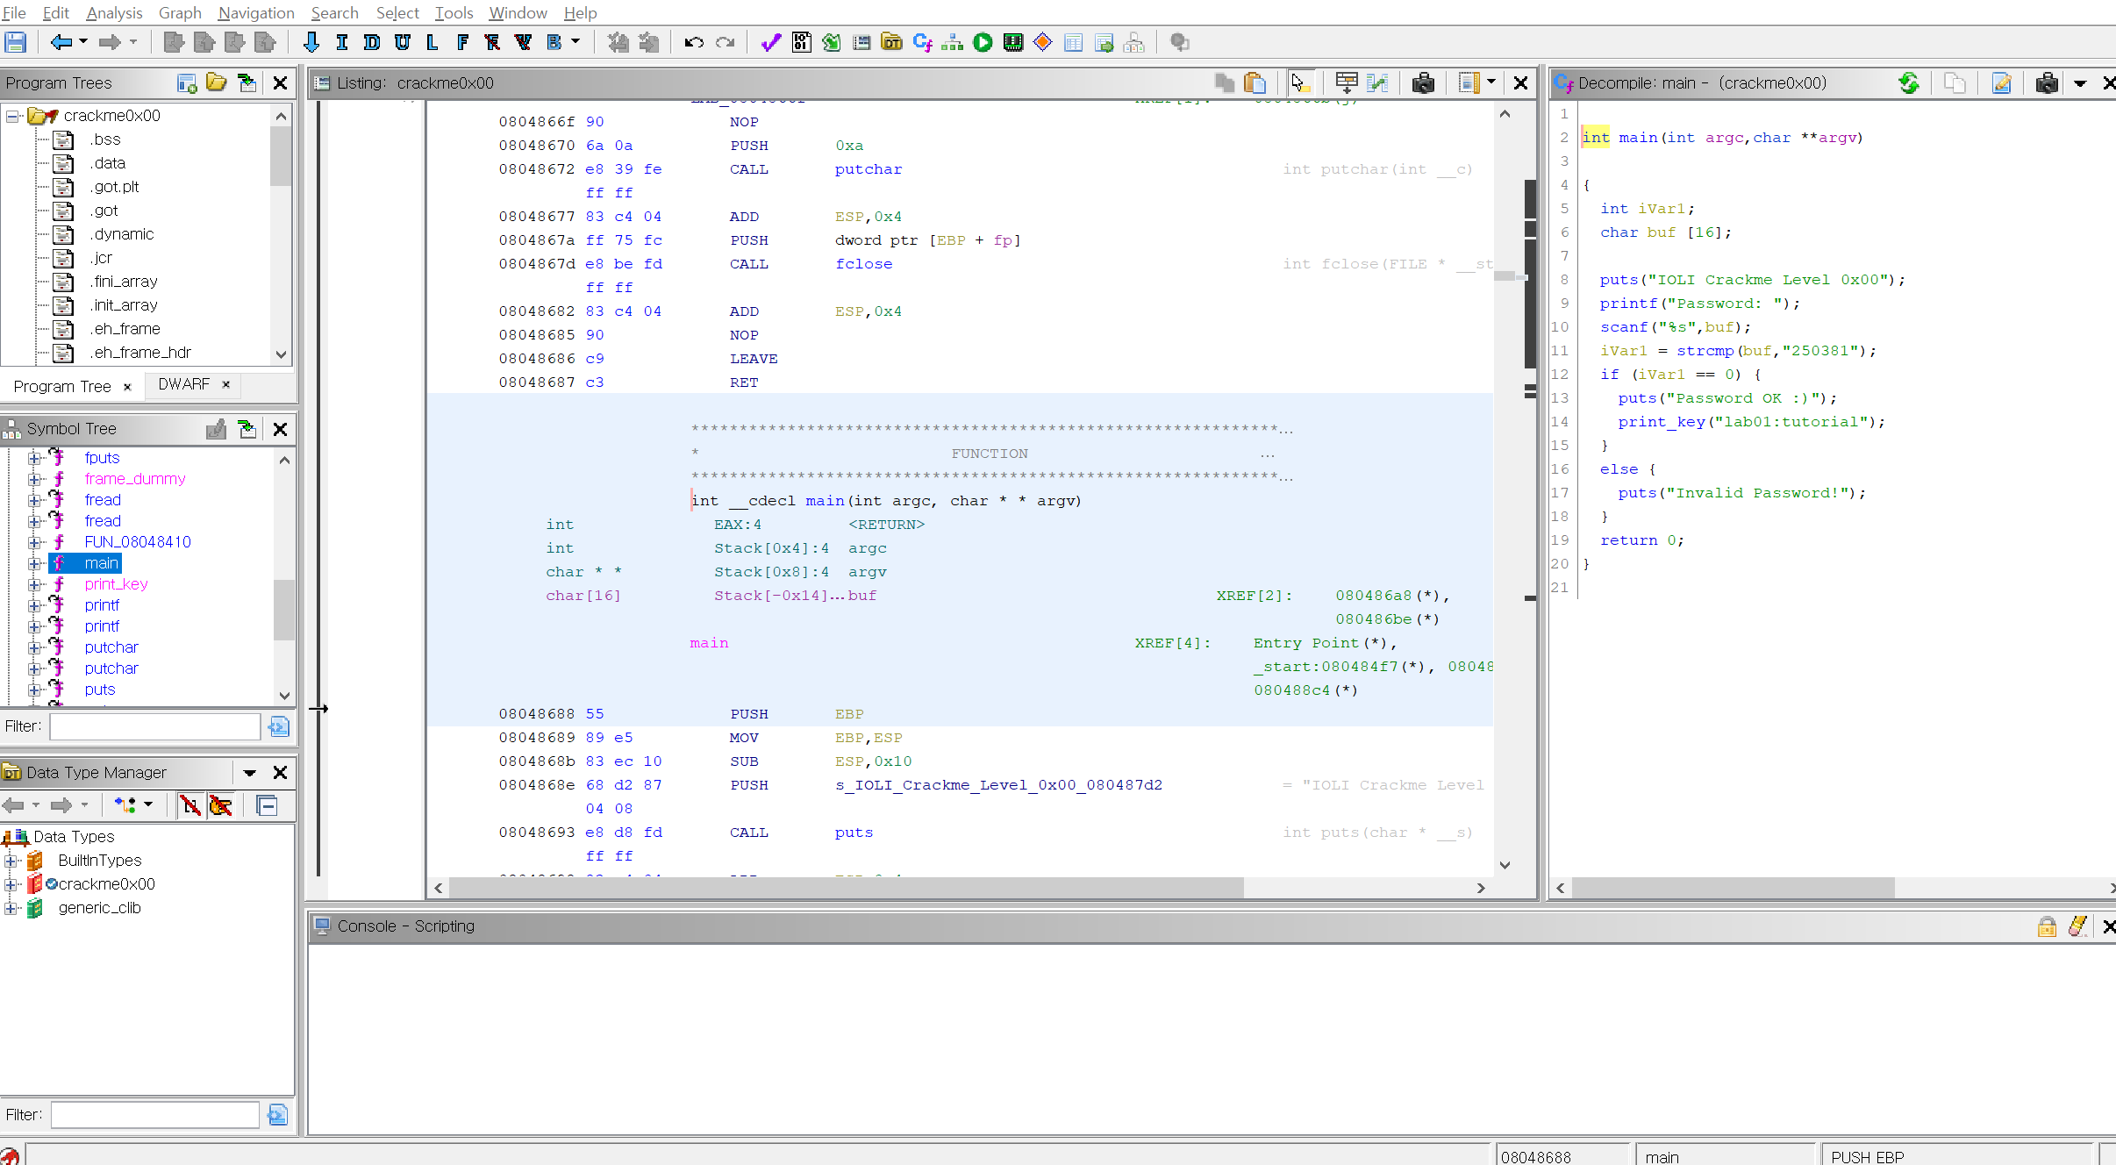
How to use ghidra
Symbol tree -> Functions -> main
Symbol Tree
Assembly
Decompiler

Slide 54
Decompiler

Slide 55
Note on bomb
Lose 5 points!
__,-~~/~ `---.
_/_,---( , )
__ / < / ) \___
- ------===;;;'====------------------===;;;===----- - -
\/ ~'~'~'~'~'~\~'~)~'/
(_ ( \ ( > \)
\_( _ < >_>'
~ `-i' ::>|--'
I;|.|.|
<|i::|i|`.
(` ^''`-' ')
BOOM!! The bomb has blown up.

Slide 56
Tip: Try to read assembly as much as you can!
Recommend: Solve *first THREE* challenges in bomblab without decompiler
Reason:
In shellcode lab, you need to write assembly code
Writing exploit requires understanding of assembly (e.g., ROP)
We have tedious binaries in later lab challenges, which make a decompiler fail to analyze

Slide 57
First assignment
Solve tut01-crackme
Solve bomblab (10 stages)

