Slide 1
Linux basic
Insu Yun

Slide 2
Announcements
Lab01 due is changed: Mar 15 → Mar 17
Please register to Piazza
Poll for your office hour
Doodle: https://doodle.com/poll/k9iqv5d6cmvbi3bn
Temporary office hour: 4pm on Friday
We will fix our office hour schedule next week!
Come to discord!

Slide 3
Agenda
Linux
File system
Permission
File-related system calls
File descriptors
Process and thread
Shell

Slide 4
What is Linux?
Unix-like operating system
Developed by Linus Torvalds
Many distributions exist
Centos
Redhat
Ubuntu 16.04 <- Our server
…

Slide 5
An operating system is software that provide
Resource management
Security
Hardware abstraction
User interface
…

Slide 6
Linux file system
A tree-based model that stores files and directories
Can check a list of files in current directory using ls command

Slide 7
Linux file system
You can get more information by typing ls -al
“.” is a current directory
“..”is a parent directory

Slide 8
Linux file permission
Q: What does this number mean?
Owner
File Owner
File Group
File type
(e.g., directory)
Group
Other
r: read, w: write,x: executable
Permissions are often expressed with the octal number (i.e., base 8)
r = 4, w = 2, x = 1
e.g., rwr-xr-x: 755
e.g., rwxrwxrwx: 777

Slide 9
Special permission: setuid, setgid
Q: Why we use setgid? not setuid?
rwr-sr-x: setgid program
e.g., rwsr-xr-x: set uid program
setgid program changes ‘effective’ gid of its user with its gid
Similar to rwx, special permissions has the octal number form
setuid: 4, setgid: 2, sticky bit: 1
The above permission would be 2755
Q: What is sticky bit?

Slide 10
Questions about permissions
uid (user id): An identifier that specifies a current user
gid (group id): An identifier that specifies a current group
Q: Can I read this?

Slide 11
Questions about permissions
Q: Can I read this?
Q: Can I read this?

Slide 12
Questions about permissions
Q: Can I read this?

Slide 13
Questions about permissions
Let’s assume we have a program that reads a file
Q: Can I read this?

Slide 14
Questions about permissions
Can I read this?

Slide 15
Questions about permissions
Now I can read it!

Slide 16
More on setgid
#include <unistd.h>
#include <sys/types.h>
#include <stdio.h>
#include <stdlib.h>
int main() {
// get permissions directly
printf("uid=%d, gid=%d, euid=%d, egid=%d\n",
getuid(), getgid(), geteuid(), getegid());
// run 'id' using execve system call
if (!fork())
execl("/usr/bin/id", "/usr/bin/id", NULL);
// run 'id' through shell
system(”/usr/bin/id");
}
system() = fork() + /bin/sh –c “COMMAND”

Slide 17
When we run setgid program…
Due to security reasons, shell (e.g., sh or bash) drops effective uid/gid
In our challenges, you will see setregid(getegid(), getegid());
It allows you to invoke shell with higher privilege
As a result, it will make you easy to exploit (otherwise, you have to call those functions by yourself)

Slide 18
A special file type: symbolic (soft) link
A special file that points another file
e.g., .lnk file in Windows
You can create it using ln command
e.g., ln –s [src] [dst]
Interesting property regarding security: You can create symbolic link even you don’t have enough permission for source
e.g., You can make symbolic link for a file even you cannot read the file, or the file has setuid permission
Q: Without –s, you can create hard link. What’s difference compared to soft link or to copy of a file?

Slide 19
Use a file system using open(), read(), write(), …
Linux (and other operating systems) can use its hardware resource including files, using system calls
int open(const char *pathname, int flags)
Opens a file specified the pathname and returns a file descriptor
ssize_t read(int fd, void *buf, size_t count)
Read up to count bytes from file descriptor fd into buf
ssize_t write(int fd, const void *buf, size_t count)
Write up to count bytes to file descriptor fd from buf
int close(int fd): close a given file descriptor, fd

Slide 20
File descriptors
An integer value used to access a file, network, or I/O operation
In Windows, HANDLE corresponds to the file descriptor
Special file descriptors
0: standard input (stdin) – Keyboard input
1: standard output (stdout) – Screen
2: standard error (stderr) – Screen and no buffering

Slide 21
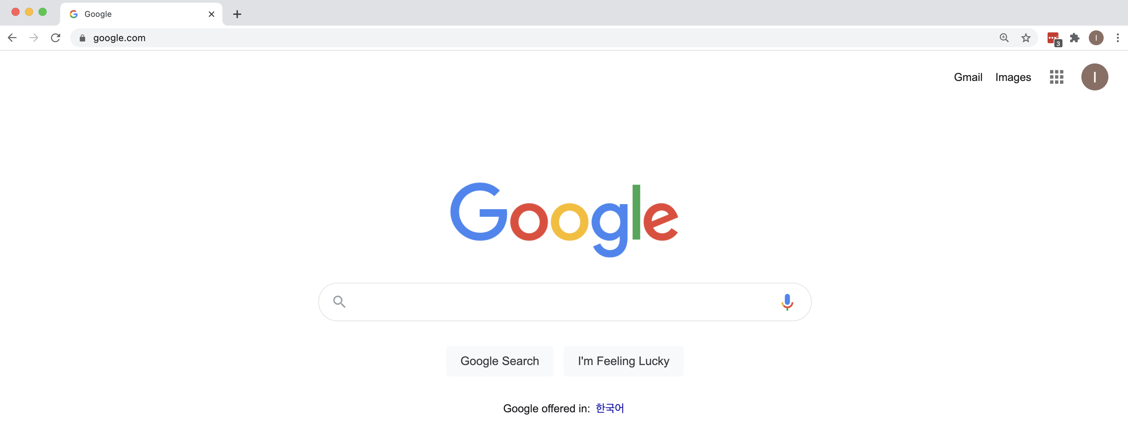
Process management: Process and thread
Program: an executable file that contains code and data for execution
Process: an executing instance of a program
Thread: an executable unit of a process
One thread can have multiple threads
Renderer thread
IO thread
UI thread
Program
…
Process
Threads

Slide 22
More example
Process ID

Slide 23
More example
Q: How many thread does this process have?
(Just guess)

Slide 24
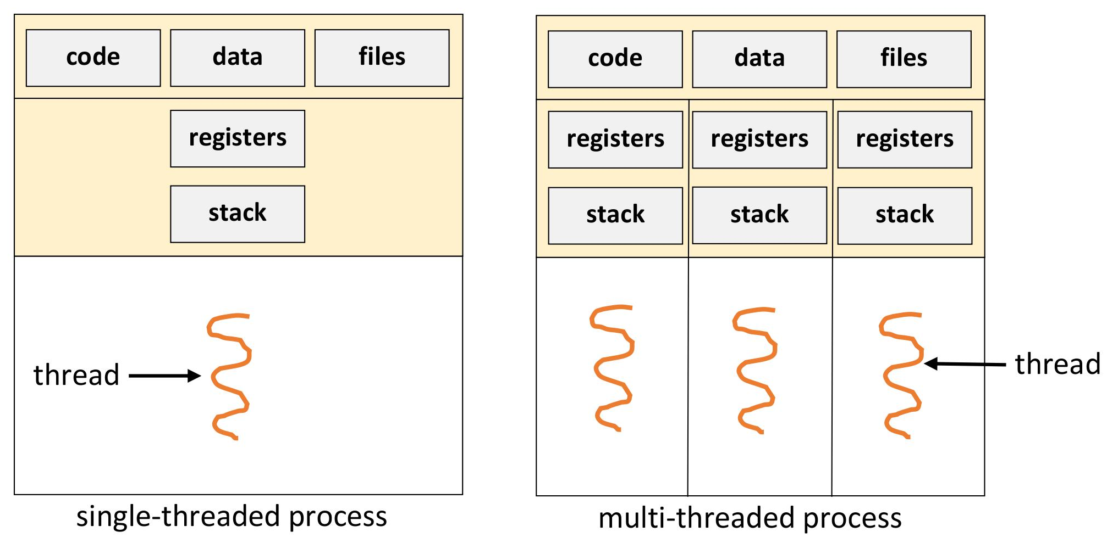
Thread vs process
Ref: https://medium.com/@yovan/os-process-thread-user-kernel-%E7%AD%86%E8%A8%98-aa6e04d35002

Slide 25
Common misconceptions
Looks like that a thread’s stack cannot be shared!
Ref: https://medium.com/@yovan/os-process-thread-user-kernel-%E7%AD%86%E8%A8%98-aa6e04d35002

Slide 26
Example: sharing stacks across threads
int* ptr = NULL;
void *thread1(void *arg1) {
int c = 0;
ptr = &c;
while (ptr != NULL); // busy waiting
printf(”c: 0x%08x\n", c);
return NULL;
}
void* thread2(void *arg) {
while (ptr == NULL); // busy waiting
printf(”ptr: %p\n", ptr);
*ptr = 0xdeadbeef;
ptr = NULL;
return NULL;
}
Threads share process memory (e.g., heap, code, data, and even stack)
Stack is just one kind of memory
StackClash: Modifying heap from stack
https://blog.qualys.com/vulnerabilities-research/2017/06/19/the-stack-clash

Slide 27
Create a process using fork()
fork(): only way to create a new process
Variants exist: clone(), vfork(), …
fork() creates a new process by duplicating the current process
Copy memory including heap, code, data, and stack
Inherits several system resources including file descriptors

Slide 28
Run a new program using execve()
int execve(const char *filename, char *const argv[], char *const envp[]);
executes a program pointed by filename
argv: arguments
argv[0] points the filename that are being executed (by convention)
envp: environment variables
Format: KEY=VALUE (e.g., HOME=/home/vagrant)

Slide 29
Process layout (32bit in x86-64)
$ ./hello aaaa bbbb cccc
Description | Example
NULL (8-byte) | NULL
File name | “/home/insu/hello”
Environment variable strings | “COLUMNS=238”, “LANG=en_US.UTF-8”, …
Argument strings | “/home/insu/hello”, “aaaa”, “bbbb”, “cccc”
… | …
Environment variables | { env1, env2, env3, …, envN, NULL }
Arguments | { arg1, arg2, arg3, arg4, NULL }
… | …
char* envp[]
char* argv[]
int argc | 4

Slide 30
Shell
A command line interpreter for *nix platforms
It provides diverse functionalities
Wildcarding (*)
Pipelining (|)
Variables
…
You can call shell commands using system() in a C program

Slide 31
How system() works?
system(”id”);
How does shell know that it needs to execute /usr/bin/id?
Answer: PATH environment variable
Type “printenv PATH”: /usr/local/sbin:/usr/local/bin:/usr/sbin:/usr/bin:/sbin:/bin:/usr/games:/usr/local/games:/snap/bin
Shell search each path until it finds the specific command

Slide 32
Vulnerability1: PATH injection
system(”id”);
Add other location to PATH variable
export PATH=/home/attacker/bin:$PATH
Make a binary named “id ” in /home/attacker/bin
Run a program that contains system(“id”)
This will invoke my “id ” binary, not /usr/bin/id

Slide 33
Vulnerability2: Command injection
system(”/bin/ls ” + input);
Shell has many meta-characers
e.g., “;” can represents command separator
Thus, if input=”; /bin/sh”, the above code will spawn a shell for you

Slide 34
Wildcard injection
system(”/bin/tar cf archive.tar *”);
You can make any file for compression
Shell inserts file names as arguments!!

Slide 35
Wildcard injection

Slide 36
Wildcard injection
--checkpoint=[N]: Display progress messages every Nth record
-- --checkpoint-action=ACTION: Run ACTION on each checkpoint
One of its action is ‘exec’, which allows you to execute external command!

Slide 37
Shellshock
Discovered in September 2014
Malformed environment variables in bash allows command injection
env x='() { :;}; echo vulnerable’ bash -c "echo this is a test"

Slide 38
Example: Common Gateway Interface (CGI)
Web interface to execute programs like console applications
Frequently used in an embedded system (e.g., router, …)
CGI converts inputs from web into environment variables
e.g., User-agent → HTTP_USER_AGENT=“….”
#!/bin/bash
echo “Content-Type: text/html”
echo
echo “<h1>Hello World</h1>”

Slide 39
Shellshock on CGI servers
env x='() { :;}; echo vulnerable’ bash -c "echo this is a test"
curl -H "User-agent: () { :;}; echo vulnerable" http://localhost/cgi-bin/hello.sh
Then, HTTP_USER_AGENT=‘() {:;}; echo vulnerable’ bash hello.sh
Lesson: Be careful when you use shell command!

