Slide 1
Stack protection
Insu Yun
Most of materials from CS419/579 Cyber Attacks & Defense in OSU

Slide 2
Objectives
Understand spatial memory safety
Understand SoftBound
Understand stack cookie
Understand weakness of stack cookie
Notes:
how to use pwntools
frame pointer attack

Slide 3
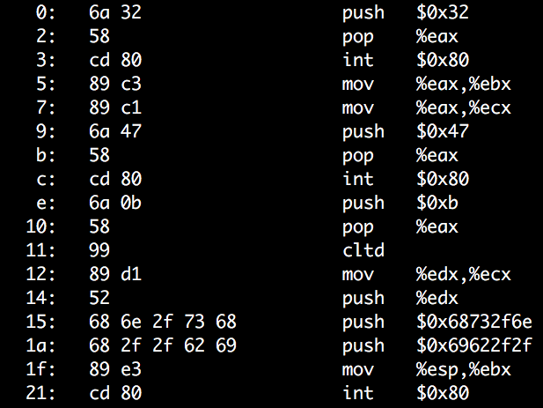
Stack Buffer Overflow + Run Shellcode
ADDR of SHELLCODE
RETURN ADDR
EEEE
SAVED %ebp
DDDD
COOKIE
BUFFER
CCCC
BUFFER
BBBB
BUFFER
AAAA
BUFFER

Slide 4
Defense
Prevent buffer overflow!
A direct defense
Could be accurate but could be slow..
Make exploit hard!
An indirect defense
Could be inaccurate but could be fast..
Exploit Mitigation
Stack cookie, DEP, ASLR, etc.

Slide 5
Defense
Base and bound check
Prevent buffer overflow!
A direct defense
Stack Cookie
An indirect defense
Prevent overwriting return address

Slide 6
Spatial Memory Safety – Base and Bound check
A FAT pointer
char *a
char *a_base;
char *a_bound;
Allocation
a = (char*)malloc(512)
a_base = a;
a_bound = a+512
Access must be between [a_base, a_bound)
a[0], a[1], a[2], …, and a[511] are OK
a[512] NOT OK
a[-1] NOT OK
A
a[-1]
Base
Bound
a[512]

Slide 7
Base and Bound Check
B
C
Propagation
char *b = a;
b_base = a_base;
b_bound = a_bound;
char *c = &b[2];
c_base = b_base;
c_bound = b_bound;
A
a[-1]
Base
Bound
a[512]

Slide 8
Base and Bound Check
B
C
Propagation
char *c = &b[2];
c_base = b_base;
c_bound = b_bound;
c[1] = ‘a’;
c== b+2 == a+2
c+1 == b+3 == a+3
c_base <= c+1 && c+1 < c_bound
c[510] = ‘a’;
c == b+2 == a+2
c+510 == b+510+2 == a+510+2 == a+512
c_base <= c+510 but c+510 >= c_bound
Disallow write!
A
a[-1]
Base
Bound
a[512]

Slide 9
Base and Bound Check
Buffer?
strcpy(c, “A”*510)
When copying 510th character:
c[510] = ’A’;
c+510 > c_bound (c+510 == a+512 > bound…)
Detect buffer overrun!
This is how Java and other languages (e.g., rust) protect buffer overrun
Even for std::vector in C++

Slide 10
In Proceedings of
Programming Language Design and Implemenetation
(PLDI) 2009

Slide 11
Drawbacks
+2x overhead on storing a pointer
char *a
char *a_base;
char *a_bound;
+2x overhead on assignment
char *b = a;
b_base = a_base;
b_bound = a_bound;
+2 comparisons added on access
c[i]
if(c+i >= c_base)
if(c+i < c_bound)
Many other problems…
Use more cache
More TLBs
etc….

Slide 12
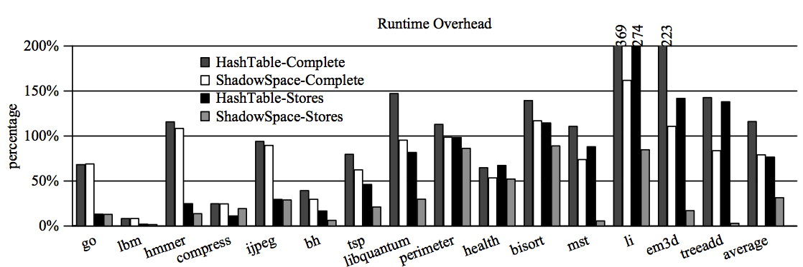

Slide 13
Security vs. Performance
100% Buffer Overflow Free
You pay +200% Performance Overhead
Think about the economy…

Slide 14
An Economic Defense: Stack Cookie
A defense specific to sequential stack overflow
On a function call
cookie = some_random_value
Before the function returns
if(cookie != some_random_value)
printf(“Your stack is smashed\n”);
RETURN ADDR
SAVED %ebp
COOKIE
BUFFER
BUFFER
BUFFER

Slide 15
Stack Cookie: Attack Example
strcpy(buffer, “AAAABBBBCCCCDDDDEEEE\x35\x45\x04\x08”)
On a function call
cookie = some_random_value
Before a function returns
if(cookie != some_random_value)
printf(“Your stack is smashed\n”);
0x8044535
RETURN ADDR
RET
EEEE
SAVED %ebp
DDDD
COOKIE
Cookie
CCCC
BUFFER
BBBB
BUFFER
AAAA
BUFFER

Slide 16
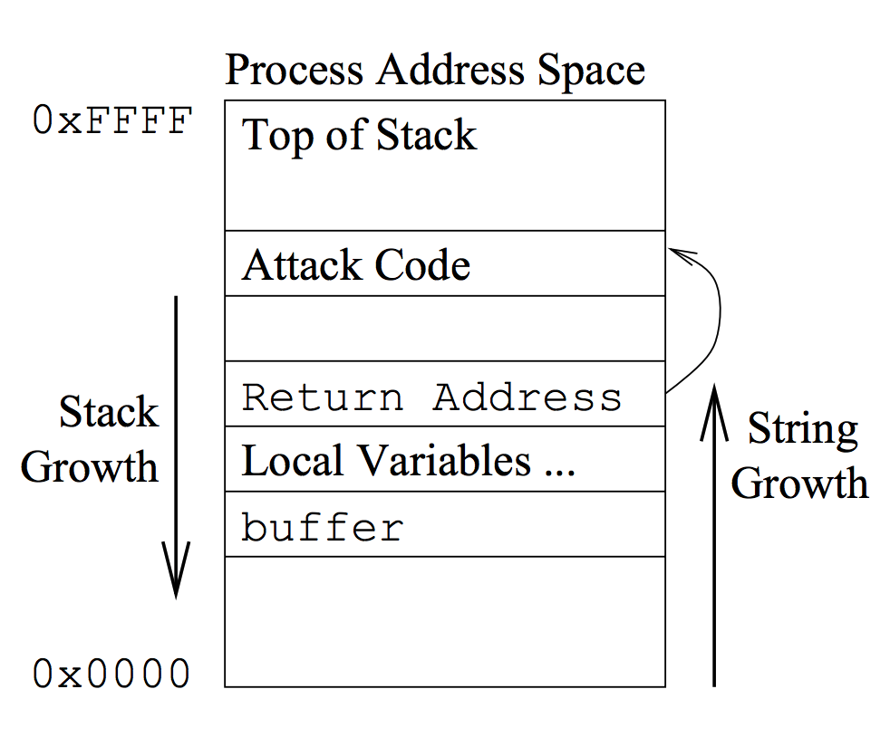
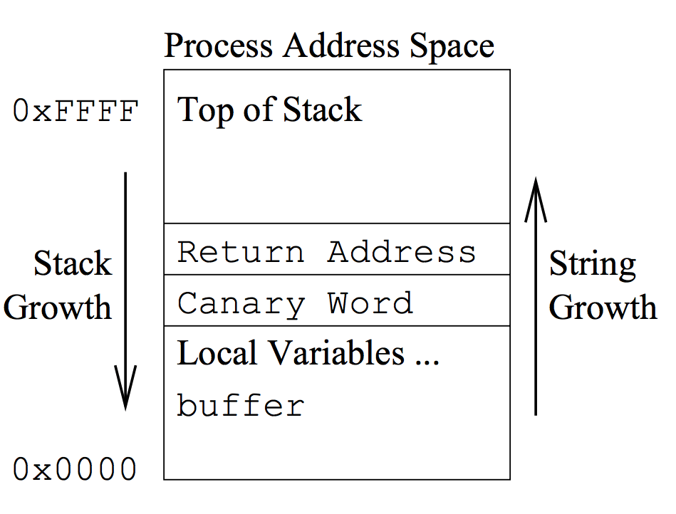
In Proceedings of
The 7th USENIX Security Symposium (1998)
RETURN ADDR
SAVED %ebp
COOKIE
BUFFER
BUFFER
BUFFER

Slide 17
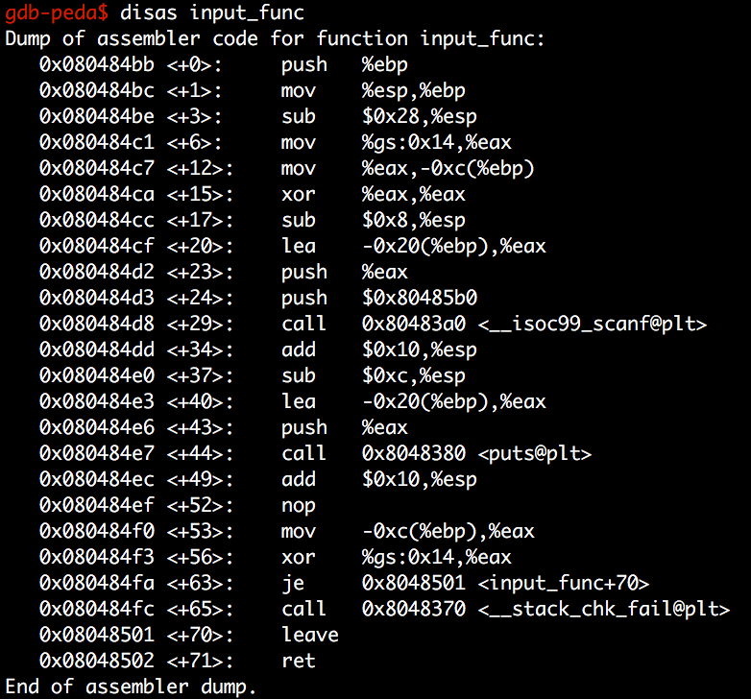
Stack Cookie
Get canary from %gs
Store canary at ebp-c
GCC ProPolice
Clear canary in %eax
Get canary in stack
Cookie stored in -0xc(%ebp)
Xor that with value in %gs

Slide 18
Stack Cookie in gcc (ProPolice)
Cookie stored in -0xc(%ebp)

Slide 19
Stack Cookie: Overhead
2 memory move
+1 for store, +1 for read
1 compare
Per each function call
1~5% overhead
Benchmark: SPECint, SPECfloat

Slide 20
Stack Cookie: Weaknesses
Effective for common mistakes
strcpy/memcpy
read/scanf
Missing bound check in a for loop
But can only block sequential overflow
What if buffer[24] = 0xaa?
aa
RETURN ADDR
SAVED %ebp
COOKIE
BUFFER
BUFFER
BUFFER

Slide 21
Stack Cookie: Weaknesses
Fail if attacker can guess the cookie value
strcpy(buf, “AAAABBBBCCCC\x44\x33\x22\x11EEEE…”)
(stack-cookie-1)
-> Use a random value for a cookie!
Is rand() safe?
See https://www.includehelp.com/c-programs/guess-a-random-number.aspx
0x8044535
RETURN ADDR
RET
EEEE
SAVED %ebp
0x11223344
Cookie
CCCC
BUFFER
BBBB
BUFFER
AAAA
BUFFER

Slide 22
Stack Cookie: Weaknesses
Security in 32-bit Random Cookie
One chance over 2³² (4.2 billion) trial
Seems super secure!
Fail if attacker can read the cookie value…
Maybe you can’t read %gs:0x14
But, what about -0xc(%ebp)?
RETURN ADDR
RET
SAVED %ebp
0x83ec5589
Cookie
BUFFER
BUFFER
BUFFER

Slide 23
Stack Cookie: Weaknesses
Security in 32-bit Random Cookie
One chance over 2³² (4.2 billion) trial
Seems super secure!
Attacker can break this in 1024 trial
If application uses fork()
RETURN ADDR
RET
SAVED %ebp
0x83ec5589
Cookie
BUFFER
BUFFER
BUFFER

Slide 24
Stack Cookie: Weaknesses
Random becomes non-random if fork()-ed..
RETURN ADDR
RET
RETURN ADDR
RET
SAVED %ebp
SAVED %ebp
0x83ec5589
Cookie
fork()!
0x83ec5589
Cookie
BUFFER
BUFFER
BUFFER
BUFFER
BUFFER
BUFFER

Slide 25
Stack Cookie: Weaknesses
RETURN ADDR
SAVED %ebp
0x83ec5589
BUFFER
Servers…
BUFFER
Why?
RETURN ADDR
fork()!
BUFFER
RETURN ADDR
SAVED %ebp
SAVED %ebp
0x83ec5589
RETURN ADDR
0x83ec5589
BUFFER
SAVED %ebp
fork()!
BUFFER
BUFFER
0x83ec5589
BUFFER
BUFFER
fork()!
BUFFER
BUFFER
BUFFER
BUFFER

Slide 26
Stack Cookie: Bypassing ProPolice
Assumption
A server program contains a sequential buffer overflow vulnerability
A server program uses fork()
A server program let the attacker know if it detected stack smashing or not
E.g., an error message, “stack smashing detected”, etc.

Slide 27
Stack Cookie: Bypassing ProPolice
0x83ec5589
Attack
Try to guess only the last byte of the cookie
0x00 ~ 0xff (256 trials)
Result
Stack smashing detected on
00, 01, 02, 03, …, 0x88
When testing 0x89
No smashing and return correctly
RETURN ADDR
SAVED %ebp
89
01
02
0x83ec5589
00
BUFFER
CCCC
BUFFER
BBBB
BUFFER
AAAA

Slide 28
Stack Cookie: Bypassing ProPolice
0x83ec5589
Attack
Try to guess the second last byte of the cookie
0x00 ~ 0xff (256 trials)
Result
Stack smashing detected on
00, 01, 02, 03, …, 0x54
When testing 0x55
No smashing and return correctly
RETURN ADDR
SAVED %ebp
89
0x83ec5589
00
55
01
02
BUFFER
CCCC
BUFFER
BBBB
BUFFER
AAAA

Slide 29
Stack Cookie: Bypassing ProPolice
An easy brute force attack
Max 256 trials to match 1 byte value
Move forward if found the value
In 32-bit: 4 * 256 = max 1,024 trials
In 64-bit: 8 * 256 = max 2,048 trials

Slide 30
Stack Cookie: Weaknesses
Random becomes non-random if fork()-ed..
RETURN ADDR
RET
RETURN ADDR
RET
SAVED %ebp
SAVED %ebp
0x83ec5589
Cookie
fork()!
0x83ec5589
Cookie
BUFFER
BUFFER
BUFFER
BUFFER
BUFFER
BUFFER

