Slide 1
Stack protection #2
Insu Yun

Slide 2
Objectives
Understand how to exploit arbitrary write
Understand other issues in stack canary
Understand shadow stack
Notes:
how to use pwntools
frame pointer attack

Slide 3
An Economic Defense: Stack Cookie
A defense specific to sequential stack overflow
On a function call
cookie = some_random_value
Before the function returns
if(cookie != some_random_value)
printf(“Your stack is smashed\n”);
RETURN ADDR
SAVED %ebp
COOKIE
BUFFER
BUFFER
BUFFER

Slide 4
Exploiting arbitrary write
How can you exploit a vulnerability that allows you to write arbitrary memory with arbitrary content?
i.e., arbitrary write
One of the most powerful exploit primitives that we can have
One way would be writing a return address as usual
Your exploit is not reliable (i.e., hard to reproduce)
A return address is not stable; it depends on your file name, environment variables, arguments, …

Slide 5
Example
How can we change eip = 0x41414141?
int main() {
intptr_t *ptr, value;
read(0, &ptr, sizeof(ptr));
read(0, &value, sizeof(value));
*ptr = value;
puts(”Hello World”);
}

Slide 6
1. GOT (Global Offset Table)
Procedure Linkage Table (PLT)
Stubs used to load dynamically linked functions

Slide 7
1. GOT (Global Offset Table)
PLT stub calls a function in its GOT entry

Slide 8
1. GOT (Global Offset Table)
struct link_map*: A data structure for shared objects
_dl_runtime_resolve(link_map*, offset):
Lazily loads a function address based on offset

Slide 9
1. GOT (Global Offset Table)
__dl_runtime_resolve
According to offset, get a function name in an ELF binary (e.g., puts)
Based on the function name, get its address
Update GOT with the address and call the function
This mechanism also can be used in attack: return_to_dl attack

Slide 10
1. GOT (Global Offset Table)
No more lookup again!

Slide 11
1. GOT (Global Offset Table)
from pwn import *
p = gdb.debug('./aaw’)
# puts@got
p.write(p32(0x804a014))
p.write("AAAA")
p.interactive()

Slide 12
2. .dtors?
If you check online materials, you might see .dtors
.dtors is a list of functions that are called after exit()
Overwriting .dtors entry makes you to. control your program counter
It had been extensively used in exploiting arbitrary write, but it is no longer available
.dtors is replaced with .fini_array
.fini_array is read-only
Remember: no .dtors anymore!

Slide 13
3. C library hooks
e.g., __malloc_hook, __free_hook: Called before and after malloc() and free()
__malloc_hook(size)
__free_hook(void*)
int main() {
intptr_t *ptr, value;
read(0, &ptr, sizeof(ptr));
read(0, &value, sizeof(value));
*ptr = value;
puts(”Hello World”);
}
Unfortunately, no malloc or free…?

Slide 14
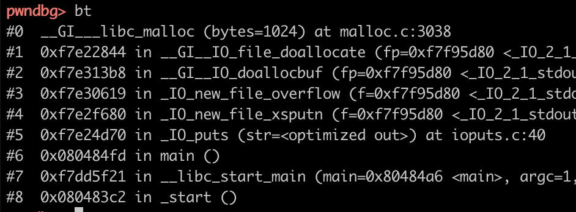
3. C library hooks
Set breakpoint before calling puts & Run
Set breakpoint on malloc()
puts() uses malloc!
(for allocating buffer)

Slide 15
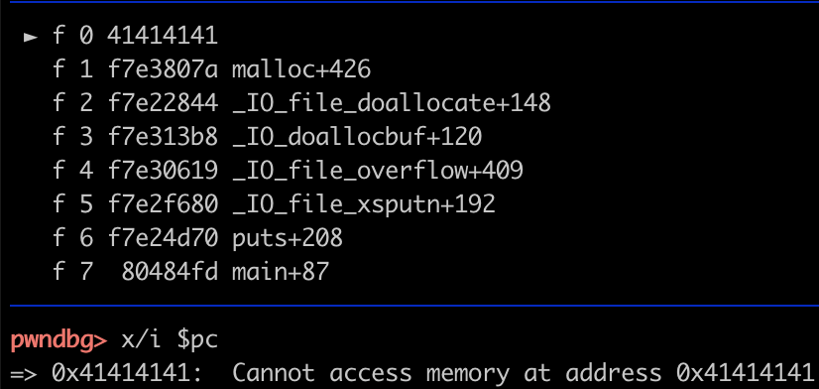
3. C library hooks
from pwn import *
p = gdb.debug('./aaw’)
p.write(p32(0xf7f95788))
p.write("AAAA")
p.interactive()

Slide 16
4. __atexit() handlers
int atexit(void (*function)(void));
Registers the given function to be called at normal process termination, either via exit(3) or via return from the program's main()
How is it implemented?
__exit_funcs: a linked list of atexit handlers
atexit handler (struct exit_function) contains a function pointer
If we can corrupt it, then we can call this function after program terminates

Slide 17
4. __atexit() handlers
PTR_MANGLE: Mitigation for __atexit() handlers
Same mechanism has been applied for __malloc_hook() and __free_hook() in the recent libc (but not ours)
Idea: Using a random secret, modify a pointer
Without leaking the secret, the pointer cannot be changeable
If you have a more powerful primitive (e.g., arbitrary read), you can exploit it
Q: Why do we need rotation?

Slide 18
5. Function pointers
Many programs contain function pointers
If you can corrupt this, then it is sufficient to control your pc
One of the example FILE* structure (e.g., fopen)
It contains virtual function table for supporting polymorphism
FILE* is more complex than you can imagine
e.g., FSOP: File structure oriented programming
Play with FILE Structure Yet Another Binary Exploitation Technique in HITB2018

Slide 19
An Economic Defense: Stack Cookie
A defense specific to sequential stack overflow
On a function call
cookie = some_random_value
Before the function returns
if(cookie != some_random_value)
printf(“Your stack is smashed\n”);
RETURN ADDR
SAVED %ebp
COOKIE
BUFFER
BUFFER
BUFFER

Slide 20
Notify your buffer overflow
In Ubuntu 18.04 (My machine)
In Ubuntu 16.04 (Our server)
Why does this change happen??

Slide 21
Think carefully when you design a mitigation
Q: Can this file name be corrupted?
A: Yes it can. It is stored in stack!
Q: If it can, what’s the consequence?
A: You can read a content of arbitrary memory (i.e., arbitrary read)
So, with stack overflow, you can still get arbitrary read
So, it is patched now! (CVE-2010-3192)

Slide 22
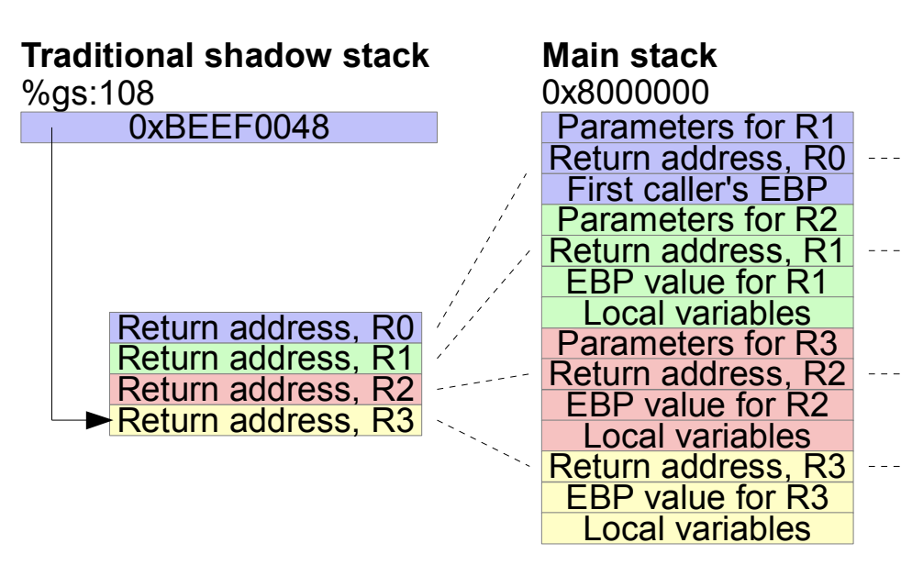
Alterative stack protection: Shadow stack
+ Not vulnerable to information disclosure
+ More secure with additional protection for shadow stack
- Performance overhead
- Backward compatibility
Ref: The Performance Cost of Shadow Stacks and Stack Canaries, AsiaCCS15

Slide 23
Trying to adopt shadow stack
Intel designed a new set of instructions with Control-flow Enforcement Technology (CET)
CALL/RET will copy its return address into shadow stack
If a return address does not match with its shadow, then exception!
Microsoft adopted CET from Windows 10 (20H1)
Linux CET patch (2020. 12. 09)
…

