Slide 1
DEP/ASLR
Insu Yun

Slide 2
Objectives
Understand Data Execution Prevention (DEP)
Understand how to bypass DEP (ret2libc)
Understand Address Space Layout Randomization (ASLR)
Understand how to bypass ASLR
Notes:
how to use pwntools
frame pointer attack

Slide 3
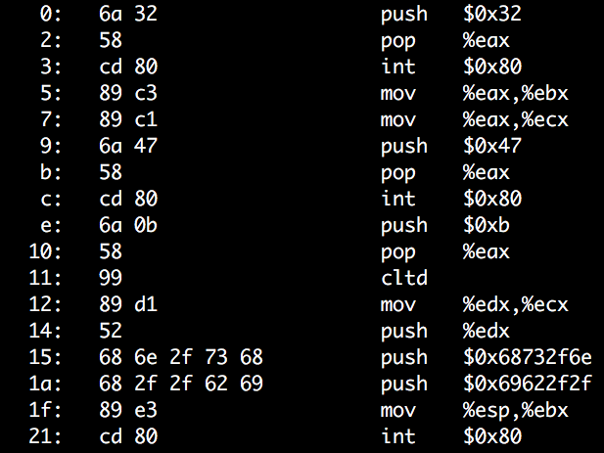
Stack Buffer Overflow + Run Shellcode
ADDR of SHELLCODE
RETURN ADDR
EEEE
SAVED ebp
DDDD
COOKIE
BUFFER
CCCC
BUFFER
BBBB
BUFFER
AAAA
BUFFER

Slide 4
Data Execution Prevention
Q: Know how to exploit a buffer overflow vuln. What’s next?
A: Jump to your shellcode!
Another Q: why do we let the attacker run a shellcode? Block it!
Attacker uploads and runs shellcode in the stack
Stack only stores data
Why stack is executable?
Make it non-executable!

Slide 6
All Readable Memory was Executable
Intel/AMD CPUs
No executable flag in page table entry – only checks RW
AMD64 – introduced NX bit (No-eXecute, in 2003)

Slide 7
All Readable Memory was Executable
Intel/AMD CPUs
No executable flag in page table entry – only checks RW
AMD64 – introduced NX bit (No-eXecute, in 2003)
Windows
Supporting DEP from Windows XP SP2 (in 2004)
Linux
Supporting NX since 2.6.8 (in 2004)
DEP, NX (No eXecute),
W⊕X (Write XOR Execute)

Slide 8
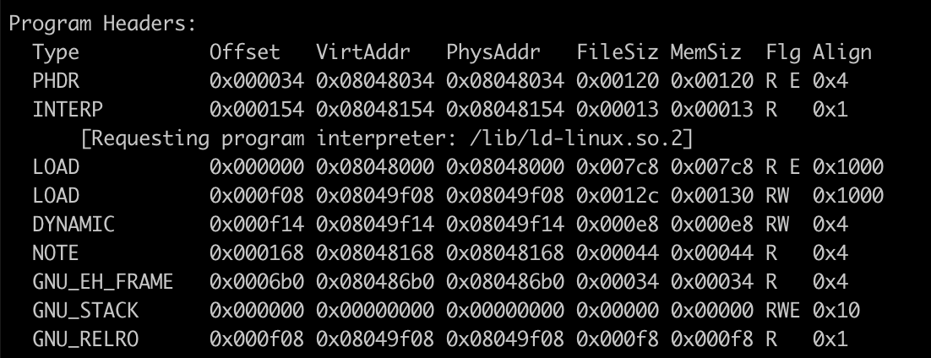
Exec / non-exec stack
$ readelf -l /home/lab05/libbase/target

Slide 9
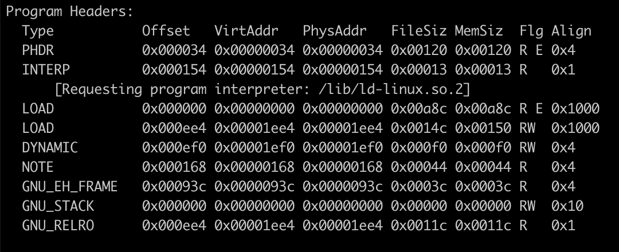
Exec / non-exec stack
$ readelf -l /home/lab03/jmp-to-stack/target

Slide 10
Non-executable Stack
Now, most of programs built with non-executable stack
We compile a program without `-z execstack`
Then, how to run a shell?
Call system(“/bin/sh”)
What if the program does not have such code?
Library: Return to Libc

Slide 11
Dynamically Linked Library
When you build a program, you use functions from library
printf(), scanf(), read(), write(), system(), etc.
Q: Where does that function reside?
1) In the program
2) In #include <stdio.h>, the header file
3) Somewhere in the process’s memory

Slide 12
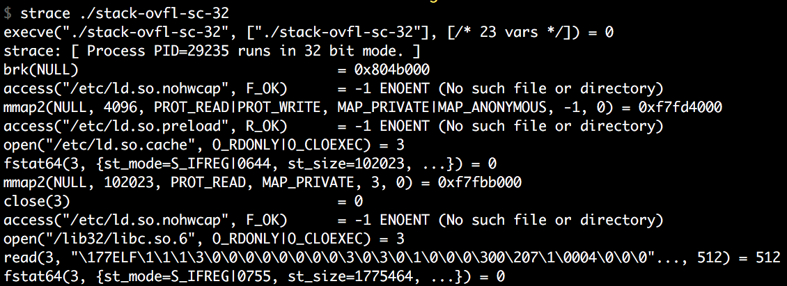
How a Program is Loaded…
execve(target, …, …)
Load the target ELF file first
Load required libraries for the target ELF (header contains the list)
Build stack, heap and other memory
Run!

Slide 13
Dynamically Linked Library: libc
The most of programs written in C will be linked with libc
Contains essential functionalities!
execve(), system(), open(), read(), write(), etc.
But where our system() is?
Let’s check with gdb!

Slide 14
Finding libc Functions
GDB
Why?
You should run the program to see linked libraries

Slide 15
Finding libc Functions
GDB

Slide 16
Stack Overflow Again
Now you know where system() is!
“A” * 0x80 + “BBBB” + “\x40\x19\xe4\xf7”
This will run system()
But how to run system(“/bin/sh”) or system(“a”)?

Slide 17
Function Call and Stack
ARG 2
Arguments
[ebp + 0x8] is the 1st argument
[ebp + 0xc] is the 2nd argument
…
What if we call system() by changing RET?
ARG 1
RETURN ADDR
RET
SAVED ebp
ebp
0x83ec5589
Local 1
Local 2
Local 3
Local 4
esp

Slide 18
Function Call and Stack
ebp = 0x41414141
ARG 2
Overflow
Leave
mov esp, ebp
mop ebp
Return
pop eip
ARG 1
esp
system()
RETURN ADDR
RET
esp
AAAA
SAVED ebp
ebp
0x83ec5589
Local 1
AAAA
AAAA
Local 2
AAAA
Local 3
Local 4
AAAA
esp

Slide 19
Function Call and Stack
ebp = 0x41414141
ARG 2
ARG 2
ebp + 0x8
Executing system()
push ebp
mov esp, ebp
sub esp, 0x10c
Argument access
What is [ebp + 8]?
ARG2 of the vulnerable function will be ARG1
Ret addr + 8!
ARG 1
ARG 1
ebp + 0x4
esp
system()
RETURN ADDR
RETURN ADDR
AAAA
ebp + 0x0
ebp
esp
AAAA
SAVED ebp
SAVED ebp
ebp
0x83ec5589
Local 1
AAAA
AAAA
Local 2
AAAA
Local 3
Local 4
AAAA
esp

Slide 20
Calling System(“/bin/sh”)
ARG 5
ARG 4
ARG 3
ARG 2
Addr of “/bin/sh”
Let’s overwrite
RET ADDR = addr of system()
ARG2 = “/bin/sh”
ARG 1
BBBB
RETURN ADDR
System()
RET
SAVED ebp
AAAA
ebp
AAAA
0x83ec5589
Local 1
AAAA
Local 2
Local 3
AAAA
Local 4
AAAA
esp

Slide 21
Calling System(“/bin/sh”)
ARG 5
ARG 4
ARG 3
ARG 2
Addr of “/bin/sh”
ebp + 8
Let’s overwrite
RET ADDR = addr of system()
ARG2 = “/bin/sh”
When running system…
ARG 1
BBBB
RETURN ADDR
AAAA
RET
ebp
SAVED ebp
AAAA
AAAA
0x83ec5589
Local 1
AAAA
Local 2
Local 3
AAAA
Local 4
AAAA
esp

Slide 22
Calling Multiple Functions
ARG 5
ARG 4
ARG 3
ARG 2
Addr of “/bin/sh”
ebp + 0x8
What if system() returns?
ebp + 0x0 = saved ebp
ebp + 0x4 = return address
Return to BBBB
Can we change this?
ARG 1
BBBB
RETURN ADDR
AAAA
RET
ebp
SAVED ebp
AAAA
AAAA
0x83ec5589
Local 1
AAAA
Local 2
Local 3
AAAA
Local 4
AAAA
esp

Slide 23
Calling Multiple Functions
ARG 5
ARG 4
Addr of “asdf”
ARG 3
ARG 2
Addr of “/bin/sh”
ebp + 0x8
system(“/bin/sh”)
printf(“asdf”)
We can run multiple functions!
ARG 1
printf()
RETURN ADDR
system()
RET
SAVED ebp
AAAA
ebp
AAAA
0x83ec5589
Local 1
AAAA
Local 2
Local 3
AAAA
Local 4
AAAA
esp

Slide 24
Stack Buffer Overflow + Run Shellcode
SHELLCODE
RETURN ADDR
EEEE
SAVED ebp
DDDD
COOKIE
BUFFER
CCCC
BUFFER
BBBB
BUFFER
AAAA
BUFFER
We need to know where the shellcode is!

Slide 25
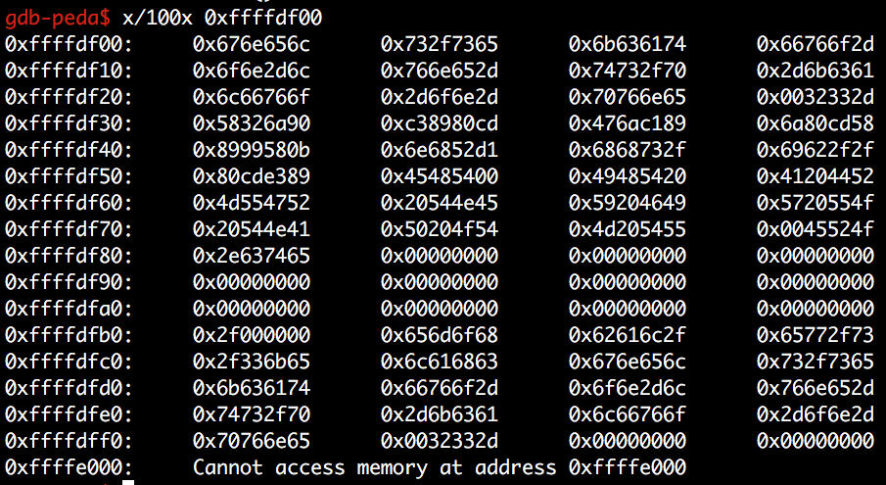
Stack Buffer Overflow + Run Shellcode
SHELLCODE
RETURN ADDR
EEEE
SAVED ebp
DDDD
COOKIE
BUFFER
CCCC
BUFFER
BBBB
BUFFER
AAAA
BUFFER
We need to know where the shellcode is!

Slide 26
Address Space Layout Randomization (ASLR)
Attackers need to know which address to control (jump/overwrite)
Stack - shellcode
Library - system()
Heap – chunks metadata (will learn this later)
Defense: let’s randomize it!
Attackers do not know where to jump…
Win!

Slide 27
ASLR - History
Linux PaX adapt this first in 2002
OpenBSD – 2003
Linux – 2005
Windows – Vista in 2007
iOS – iOS 4.3 in 2011
Android – Android 4.0 ICS in 2011

Slide 28
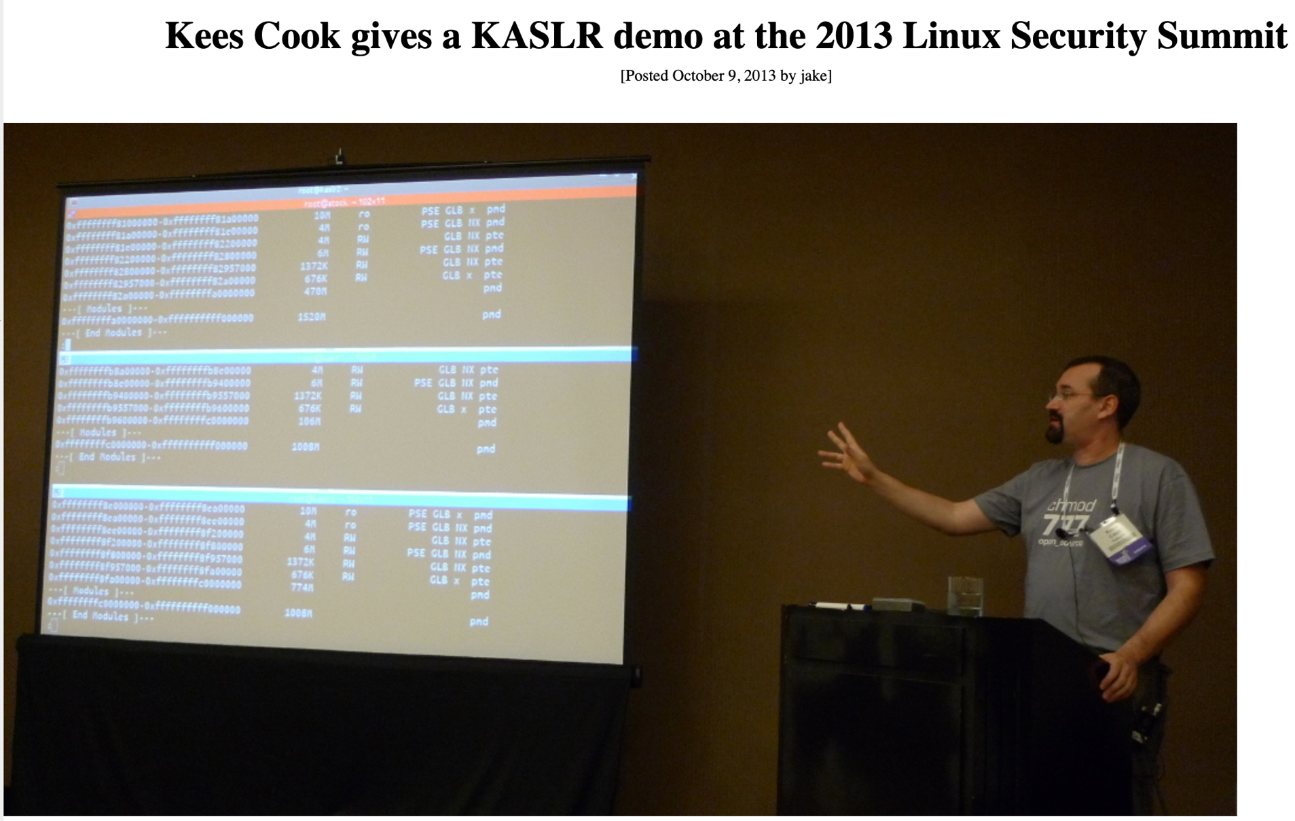
ASLR - History

Slide 29
ASLR: Randomize Addresses per Each Execution

Slide 30
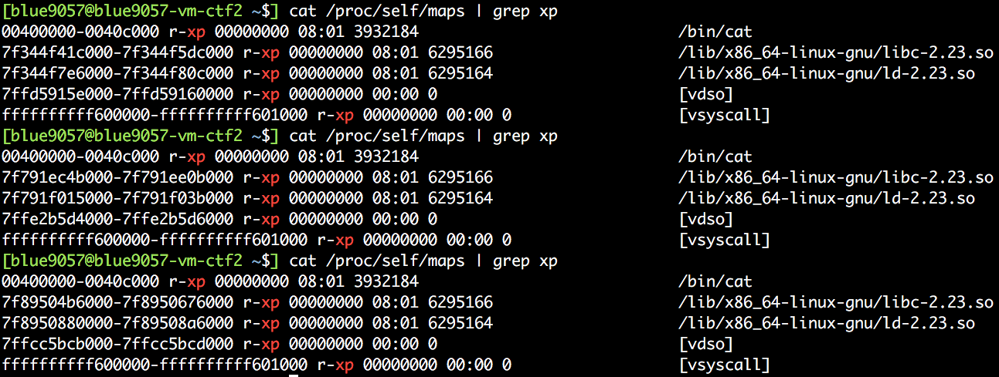
How Random is the Address?
Space | Entropy | Chance
32bit stack | 19 bits | 1 in 524288
32bit heap | 13 bits | 1 in 8192
32bit library | 8 bits | 1 in 512
64bit stack | 30 bits | 1 in 1G…
64bit heap | 28 bits | 1 in 128M
64bit library | 28 bits | 1 in 128M
64bit Windows | 19 bits | 1 in 524288

Slide 31
Overhead?
CODE
PRINTF
0x23423
<1% in 64 bit
printf(”asdf”)
Access all strings via relative address from current %rip
lea 0x23423(%rip), %rdi
~ 3% in 32 bit
Cannot address using %eip
How?
call +5; pop %ebx; add $0x23423, %ebx;← GETTING EIP to EBX
DATA
”asdf”

Slide 32
Then, How Can We Bypass ASLR?
Brute-force
Get a core dump
Set that address
Run for N times!
Eventually the address will be matched..
Look at the table
Requires too many trials in some cases…
Space | Entropy | Chance
32bit stack | 19 bits | 1 in 524288
32bit heap | 13 bits | 1 in 8192
32bit library | 8 bits | 1 in 512
64bit stack | 30 bits | 1 in 1G…
64bit heap | 28 bits | 1 in 128M
64bit library | 28 bits | 1 in 128M
64bit Windows | 19 bits | 1 in 524288

Slide 33
Leak address
Information Leak
Leak the target address!
libc? Where is the system()?
Leaking a target address (e.g., system()) could be difficult
system() should be used in a program
Our bug should be located near the use of system()

Slide 34
Understanding ASLR Characteristics
How do they randomize the address?
Change the BASE address of each area
Use relative addressing in the area

Slide 35
Relative Addressing
Addresses are different,
But their distances are the same

Slide 36
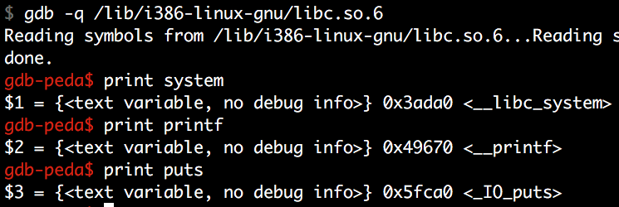
ASLR Bypass Strategy
Library
ldd first
Open that library with gdb
Print functions!
Prints offset
Attacking Library
Leak one library address (e.g., FUNC_A)
Find what is the base address: LIBC_BASE = LEAK – OFFSET_A
Calculate system: SYSTEM = LIBC_BASE + OFFSET_SYSTEM

Slide 37
ASLR bypass in pwntools version
from pwn import *
libc = ELF('/lib/i386-linux-gnu/libc.so.6’)
printf_address = 0xf7e0e430 # leak()
libc_base = printf_address - libc.symbols['printf’]
# check page align
assert(libc_base & 0xfff == 0)
system_base = libc_base + libc.symbols['system']

Slide 38
CAVEAT
To have a strong defense, systems have to randomize all addresses
Code, data, stack, heap, library, mmap(), etc.
However, Code/data still merely randomized
Why? Some compatibility issue…

Slide 40
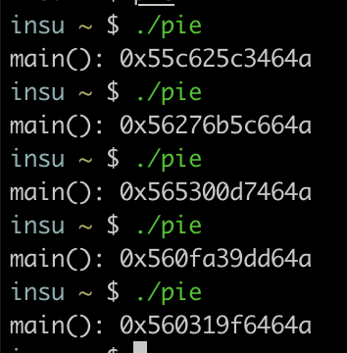
Position Independent Executable (PIE)
Randomize Code/Data!
Now everything becomes randomized
Unlike libraries, you need to recompile code
Why?
Now, PIE becomes default.
i.e., If you compile a program with a recent compiler, your main() will be randomized

Slide 41
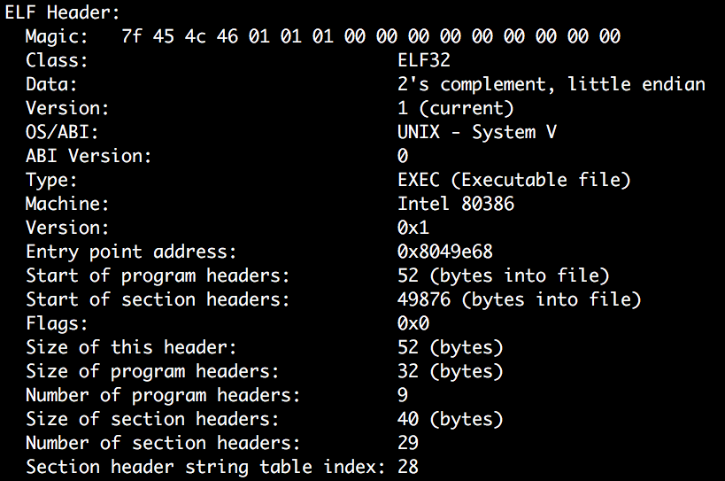
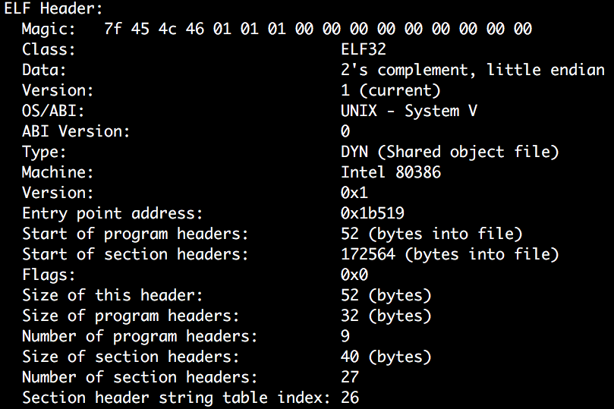
Position Independent Executable (PIE)
/bin/cat from Ubuntu 16.04.3
/bin/sh from Ubuntu 16.04.3

