Slide 1
Format string bug
Insu Yun
Most of materials from CS419/579 Cyber Attacks & Defense in OSU

Slide 2
Objectives
Understand a format string bug

Slide 3
Format string
A string to specify a format of a certain functions (e.g., printf) in C and other languages
e.g., printf(“%s”, buf);
e.g., printf(“%d”,10);
…

Slide 4
printf() is a variadic function
Variadic function: a function that can accept arbitrary number of arguments
For example,
printf(“Hello: %d”, 10);
printf(“Hello: %d/%d”, 10, 20);
printf(“Hello: %d/%d/%d”, 10, 20, 30);
Q: How does printf() know the number of arguments?
By parsing the format string!

Slide 5
Q: What if we miss arguments?
printf(“Hello: %d/%d/%d, 10, 20);
Q: Where does this (garbage) value come from?

Slide 6
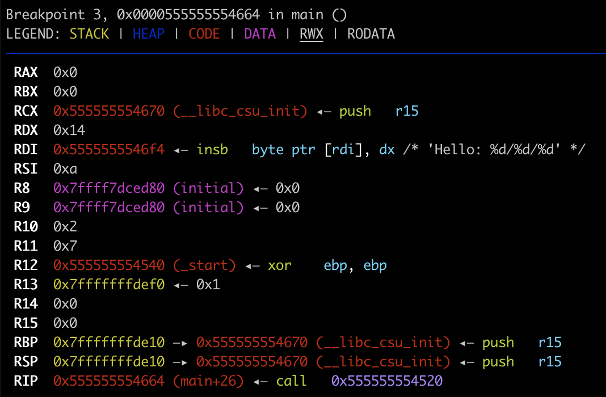
RCX=4th argument in x86-64
RCX = 0x555555554670
%d: 4byte integer
0x55554670 = 1431651952
printf() blindly trusts a format string!

Slide 7
Format string bug
What if an attacker can control a format string?
e.g., printf(buf);
Consequence
Arbitrary stack read
More than 6th arguments, printf() will use stack!
Arbitrary read
Arbitrary write

Slide 8
Format string parameters
%d
Expects an integer(4-byte) as its argument and print a decimal number
%x
Expects an integer(4-byte) as its argument and print a hexadecimal number
%p
Expects a pointer value as its argument and print a hexadecimal number
%s
Expects an address to a string (char *) and print it as a string
%n
Expects an address and write the number of printed bytes

Slide 9
Format string syntax
%[argument_position]$[flag][length][parameter]
Meaning
Print an integer as a decimal value
Justify its length to length
Get the value from n-th argument
e.g., flag = 0, padding with ‘0’
%1$08d
Print 8-length decimal integer, with the value at the 1st argument padded with 0

Slide 10
Format String Parameters
%d – Integer decimal %x – Integer hexadecimal %s – String
printf(“%2$08d”, 15, 13, 14, “asdf”);
00000013
printf(“0x%3$08x”, 15, 13, 14, “asdf”);
0x0000000d
printf(“%3$20s”, 15, 13, 14, “asdf”);
printf(“%4$20s”, 15, 13, 14, “asdf”);
asdf

Slide 11
Format String Parameters
%n – store # of printed characters
int i;
printf(“asdf%n”, &i);
i = 4
printf(“%12345x%n”, 1, &i);
Print 1 as 12345 characters (“ ” * 12344 + “1”)
Store 12345 to i

Slide 12
Example
int main() {
char buf[0x1000];
fgets(buf, sizeof(buf), stdin);
printf(buf);
}
NEVER ignore compiler warnings!

Slide 13
Arbitrary stack read via FSB
int main() {
char buf[0x1000];
fgets(buf, sizeof(buf), stdin);
printf(buf);
}
Q:What is 0x70313125?
0x70313125 == %11p
Q:Why our format string is in the stack?

Slide 14
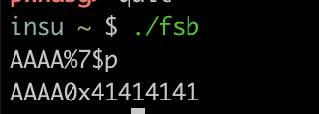
Arbitrary Read via FSB
RETURN ADDR
SAVED %ebp
The buffer is on the stack
Q: What number should be to print 0x41414141?
AAAA%????$p
Buffer address: 0xffffbeac
ESP: 0xfffbe90
Offset: 0xffffbeac - 0xfffbe90 = 28
%??$p
AAAA
…
arg 1 of printf

Slide 15
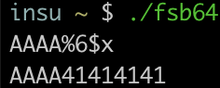
Arbitrary Read via FSB (64bit)
Q: In x86-64, what would be the number?
AAAA%????$x
Buffer = RSP = 0x7ffffffcc50
Offset = 0

Slide 16
Arbitrary Read via FSB (%s)
RETURN ADDR
SAVED %ebp
Put address to read on the stack
Suppose the address is 0x804a010 (GOT of printf)
Prepare the string input
“\x10\xa0\x04\x08%7$x” (print 0x804a010, test it first)
“\x10\xa0\x04\x08%7$s” (read the data!)
%7$s
0x804a010
…
arg 1 of printf

Slide 17
Arbitrary Read via FSB (%s)
Capability
Can read “string” data in the address
Read terminates when it sees “\x00”
Tricks to read more…
“\x10\xa0\x04\x08\x11\xa0\x04\x08\x12\xa0\x04\x08\x13\xa0\x04\x08”
“%7$s|%8$s|%9$s|%10$s”
You will get values separated by | (observing || means that it is a null string)
E.g., 1|2||3 then the value will be “12\x003”

Slide 18
Arbitrary Write via FSB (%n)
RETURN ADDR
SAVED %ebp
Put address to read on the stack
Suppose the address is 0x804a010 (GOT of printf)
Prepare the string input
“\x10\xa0\x04\x08%7$x” (print 0x804a010, test it first)
“\x10\xa0\x04\x08%7$n” (write the data!)
Will write 4, because it has printed “\x10\xa0\x04\x08”
before the %7$n parameter
%7$n
0x804a010
…
arg 1 of printf

Slide 19
Arbitrary Write via FSB (%n)
Can you write arbitrary values? Not just 4?
%10x – prints 10 characters regardless the value of argument
%10000x – prints 10000 …
%1073741824x – prints 2^30 characters …
How to write 0xfaceb00c?
%4207489484x
NO….

Slide 20
Arbitrary Write via FSB (%n)
Challenges…
Printing 4 billion characters is super SLOW…
Remote attack – you need to download 4GB…
What about 64bit machines – 48bit addresses?
A trick
Split write into multiple times (2 times, 4 times, etc.)

Slide 21
Arbitrary Write via FSB (%n)
Writing 0xfaceb00c to 0x804a010
Prepare two addresses as arguments
“\x10\xa0\x04\x08\x12\xa0\x04\x08”
Printed 8 bytes
Write 0xb00c at 0x0804a010 [ %(0xb00c-8)x%n], %45060x%n
This will write 4 bytes, 0x0000b00c at 0x804a010 ~ 0x804a014
Write 0xface at 0x804a012 [ %(0xface – 0xb00c)x%n], %19138x%n
This will write 4 bytes, 0x0000face at 0x804a012 ~ 0x804a016
What about 0x0000 at 0x804a014~0x804a016?
We do not care if it does not break our exploit!

Slide 22
What if it breaks?
%hhn: Write only two byte
%hhn: Write only one byte
Instead of %19138x%n → %19138x%hn

Slide 23
Arbitrary Write via FSB (%n)
Can we overwrite 0x12345678?
Write 0x5678 to the address
% (0x5678 – 8) n
Write 0x1234 to the (address + 2)
% (0x1234 – 0x5678) n
% (0x011234 – 0x5678) n
“\x10\xa0\x04\x08\x12\xa0\x04\x08%22128x%7$n%48060x%8$n

Slide 24
FSB in pwntools
“\x10\xa0\x04\x08\x12\xa0\x04\x08%22128x%7$n%48060x%8$n”

Slide 25
Arbitrary Code Execution via FSB
Suppose we can control FSB twice
Our scenario
Leak LIBC address
Modify GOT to system()
Where to leak to get libc address?

Slide 26
Two ways to get libc addresses
Read GOT (e.g., printf@got) using arbitrary read
Q: It should be a libc function that was already executed before. Why?
A: GOT will have a plt address before it is dynamically resolved After that, GOT will have an actual address
Read main()’s return address
main() is called by a libc function named __libc_start_main
So, its return address points to somewhere in the middle of __libc_start_main
e.g., main’s return address == __libc_start_main+241

Slide 27
How to break PIE using FSB?
No absolute address is available (i.e., all random!)
Arbitrary stack read from FSB uses relative address
If a binary calls a function, its return address will point the binary
Using arbitrary stack read from FSB, we can leak this value and can calculate a binary base

Slide 28
printf() is more powerful!
printf() is Turing complete by itself
https://github.com/HexHive/printbf
Brainf**k interpreter using printf()
Only using printf(), you can make an arbitrary program
Carlini, Nicholas, et al. "Control-flow bending: On the effectiveness of control-flow integrity." 24th {USENIX} Security Symposium ({USENIX} Security 15). 2015.

